Slide 1

Lightweight Embedded Security Protection System under RISC-V Architecture
FYP by Charlie (Bofu Chang)
Bofu Chang, an Automation student from Harbin Institute of Technology, Shenzhen.
Interested in software coding and hardware application.

Slide 2
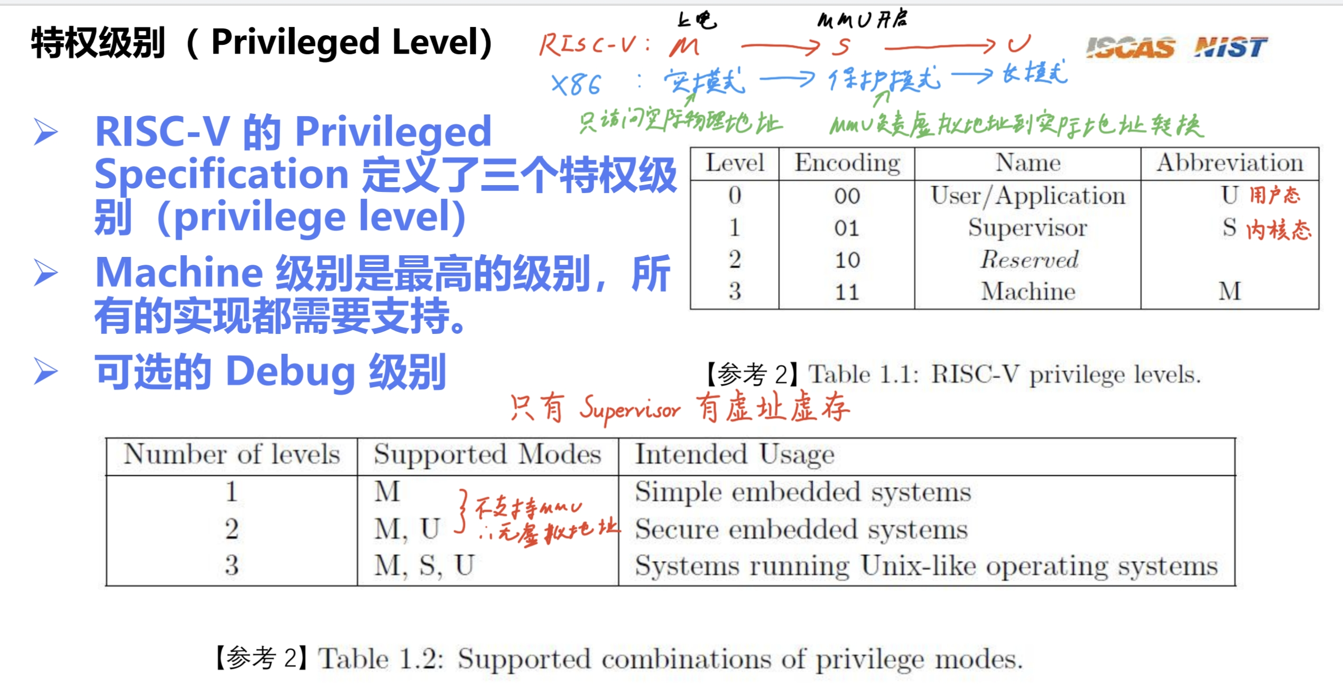
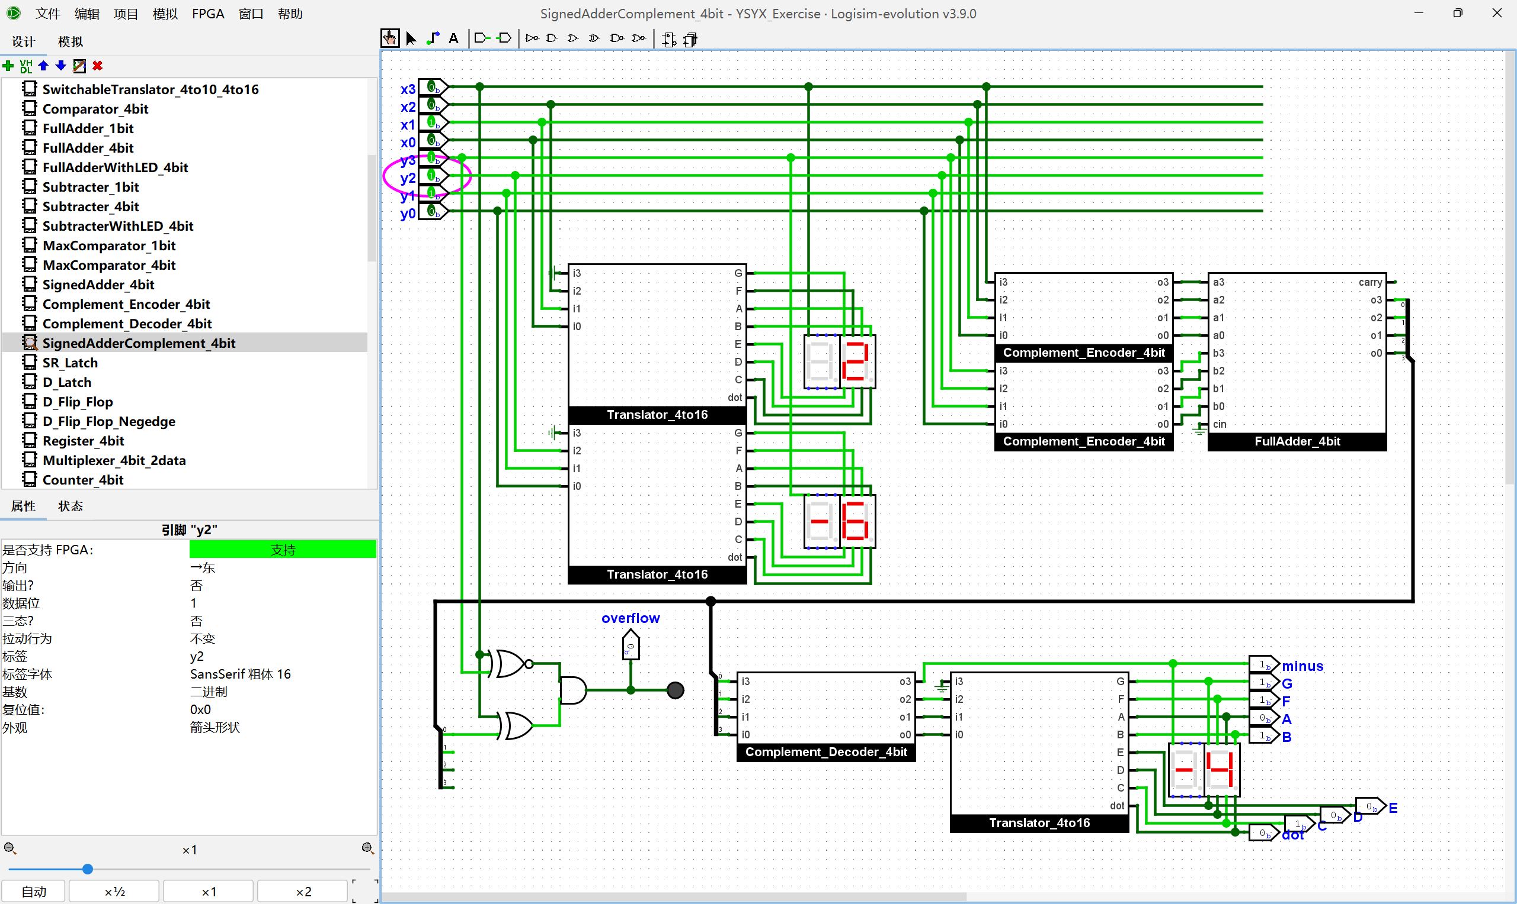
Pre-FYP Progress
Learning basic knowledge of RISC-V
Following YSYX and reviewing DC knowledge

Slide 3
FYP Timeline 0.0
Sept - Oct
2025
Literature research: security vulnerability cases, current protective plans
Learn RISC-V privileged architecture and PMP module, simulate RISC-V core by QEMU
Oct - Nov
2025
Design hardware encryption module: write logic of simplified AES-128 by Verilog
Connect encryption module (Xilinx Artix-7) and RISC-V development board (GD32VF103)
Nov - Jan
2025 - 2026
Permission isolation module: write PMP configuration code in M mode
Integrate modules into RISC-V development board and debug the logic of inter-module calls
Feb - Mar
2026
Determine the requirements of the protection system
Hardware function verification using oscilloscope
Encryption and verification module: write simplified SHA-256 by C++ and driver of AES module
Mar - Apr
2026
Attack simulation test: buffer overflow attacks and firmware tampering
Graduation thesis and thesis defense
Performance optimization: reduce memory usage and increase speed of the encryption module
Compatibility test: Verify system functionality on different RISC-V boards (like Nuclei N307)

Slide 4
Sept. 5 – Sept. 12 2025 Week 1 Progress
Literature research

Slide 5
Determine the scope of the research
Vulnerability type
Permission isolation failure
Firmware tampering
Side-channel attack
Interface abuse
Protective technologies
PMP (Physical Memory Protection)
Privilege level mechanism
Hardware encryption
Secure boot
Application scenarios
Resource-constrained embedded devices

Slide 6
SoC Platform Security: Why RISC-V? A Survey and Analysis on SoC Platform Security in ARM, Intel and RISC-V Architecture, Nicholas et al
Proprietary Architectures
Open-source Architecture
ARM TrustZone
Vulnerable to cache-based side-channel attacks
Intel SGX
Vulnerable to enclave malwares
Also vulnerable to cache-based side-channel attacks
Main reason: lack of flexibility
RISC-V
Different privilege modes
Sanctum Model
RISC-V MultiZone Security
Adding security features to the existing model
Anti Side-channel Attacks: implement different countermeasures in the existing framework
Facilitates the open community to participate in finding and fixing security vulnerabilities

Slide 7
Sept. 12 – Sept. 19 2025 Week 2 Progress
Literature research & Refreshed FYP timeline

Slide 8
An Exploration on Various Possible Solutions (Part I)
Dimensions | CM32M433R (Hardware Encryption) | CM32M433R (Software Encryption) | Kendryte KD233 (Hardware Encryption)
Price (2025) (CNY) | 112 (Tax included) | Same as left | 220
Power Consume(Typical) | Low (≈50mA) | Extra ≈10% consumption | 300mW (Idle)
Encryption Performance (AES-128) | ≥110KB/s (144 MHz, DMA) | 10~15KB/s (tiny-AES-c) | ≈80KB/s (K210 datasheet)
Permission Isolation | 8, support M/S/U mode | Same as left | 8, only M mode
Firmware Tampering | Hardware Verification (OTP) | Software Verification (Bootloader) | Bootloader (without hardware enforcement)
Side-channel Attack | TRNG Mask + Dynamic Random Delay | TRNG Mask | Software mask (K210 TRNG)
Interface Abuse | Peripheral Registers Lock + Interruption Monitoring | Same as left | SPI registers lock (only M mode, no dynamic monitoring)
Development Difficulty | Low (Nuclei Studio) | Same as left | Medium (CH340 issues)
Applicable Scene | Lightweight industrial control, IoT | Low-cost verification | Edge AI + Lightweight Security

Slide 9
An Exploration on Various Possible Solutions (Part II)
Dimensions | GD32VF103 + ATECC608B | GD32VF103 + Artix-7 | Sifive Hifive1 Rev B (Halt Production)
Price (2025) (CNY) | 80 + 50 = 130 | 80 + 1000~2000 | ≈500 before halt
Power Consume(Typical) | Low (≈30mA + ≈0.03μA) | High (FPGA ≈1W) | ≈80mA
Encryption Performance (AES-128) | 50KB/s (without I2C cost) | 200KB/s (Encryption module under Verilog, without I2C cost) | ≈100KB/s
Permission Isolation | 4, only M mode | Need custom MPU for FPGA | 8, support L locking bit
Firmware Tampering | Hardware & Software cooperation | VF103 Software Verification | Hardware Verification (Hifive1 HSM)
Side-channel Attack | 608B Built-in Protection | FPGA Custom Mask | Software mask
Interface Abuse | VF103 PMP + 608B Interface Whitelist | Custom bus monitoring | PMP + Peripheral Access Whitelist
Development Difficulty | Medium (Dual-bus Communication) | High (Verilog + Dual-bus Communication) | Medium (Freedom Studio)
Applicable Scene | Ultra-low-cost IoT | Customized Encryption | -

Slide 10
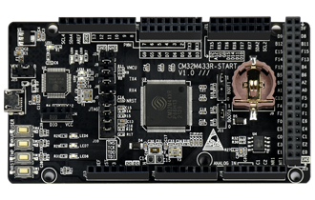
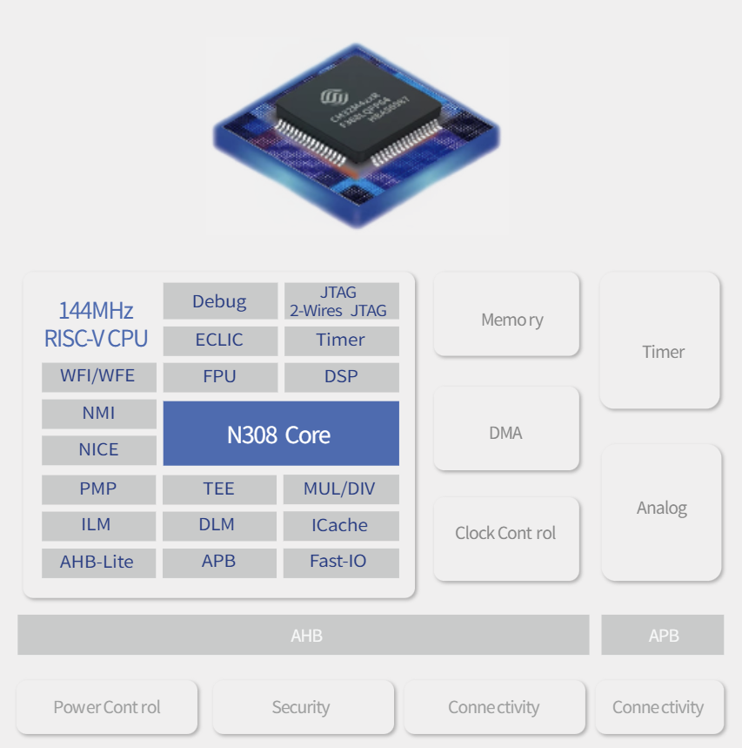
Final Solution: CM32M433R
Hardware Encryption (AES-128)
SAC module, support AES-128/192/256 and CBC/ECB/CTR modes
Permission Isolation (PMP)
8 programmable regions, each can be configured with R/W/X permissions
Can lock sensitive addresses (AES register, SPI register)
Firmware Tampering Protection (OTP + FLASH verification)
OTP stores the SHA-256 baseline value
FLASH supports hardware ECC verification (1-bit error correction / detection)
Side-channel Attack Protection (TRNG mask)
Invoke TRNG to generate an 8-bit random mask
XOR mask the input data in AES
Interface Protection (PMP locks SPI register, GPIO lock)

Slide 11
FYP Timeline 1.0
Sept - Oct
2025
Install Nuclei Studio, complete GPIO lighting up, enable UART debugging
Oct - Nov
2025
Hardware / software AES development
Nov - Jan
2025 - 2026
Hardware / software side-channel protection
Feb - Mar
2026
Mar - Apr
2026
Mid-term oral examination
Graduation thesis & thesis defense
Literature research / review
Thesis proposal
Hardware / software firmware verification
Hardware / software interface protection
System integration & encryption stress test
Conduct negative tests
Collect data and materials

Slide 12
Sept. 19 – Oct. 3 2025 Week 3-4 Progress
Get familiar with hardware & Literature research

Slide 13
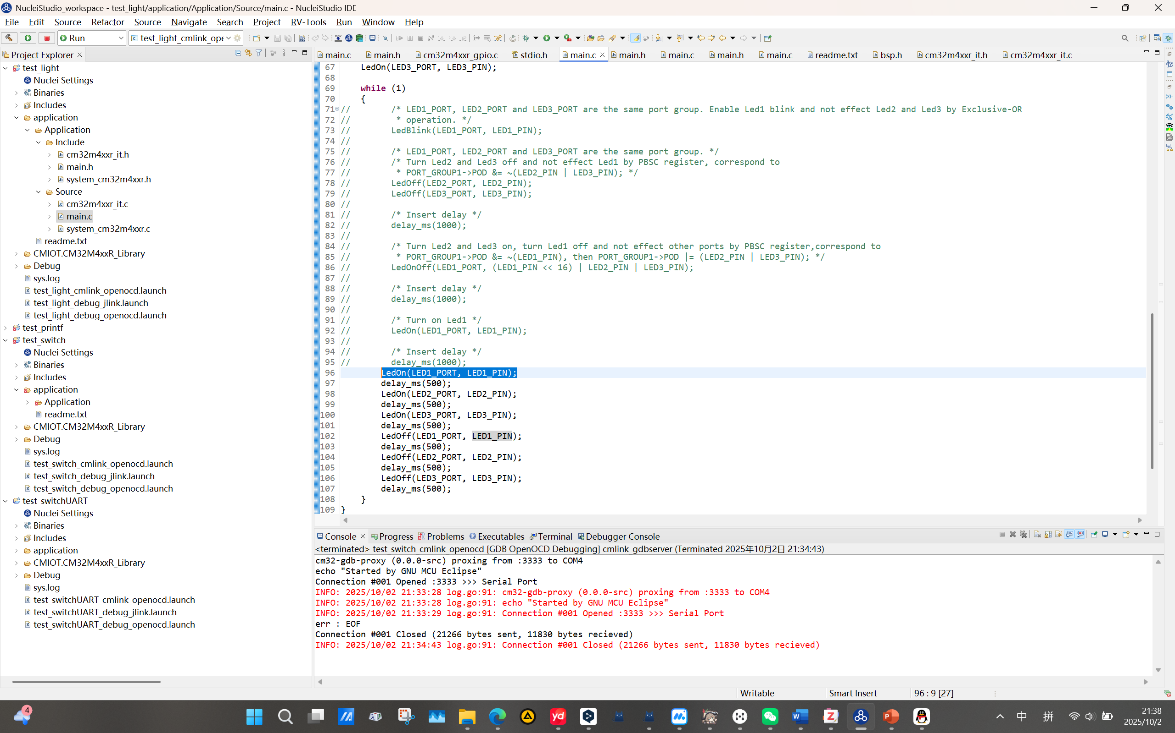
Get Familiar with Hardware - Blink

Slide 14
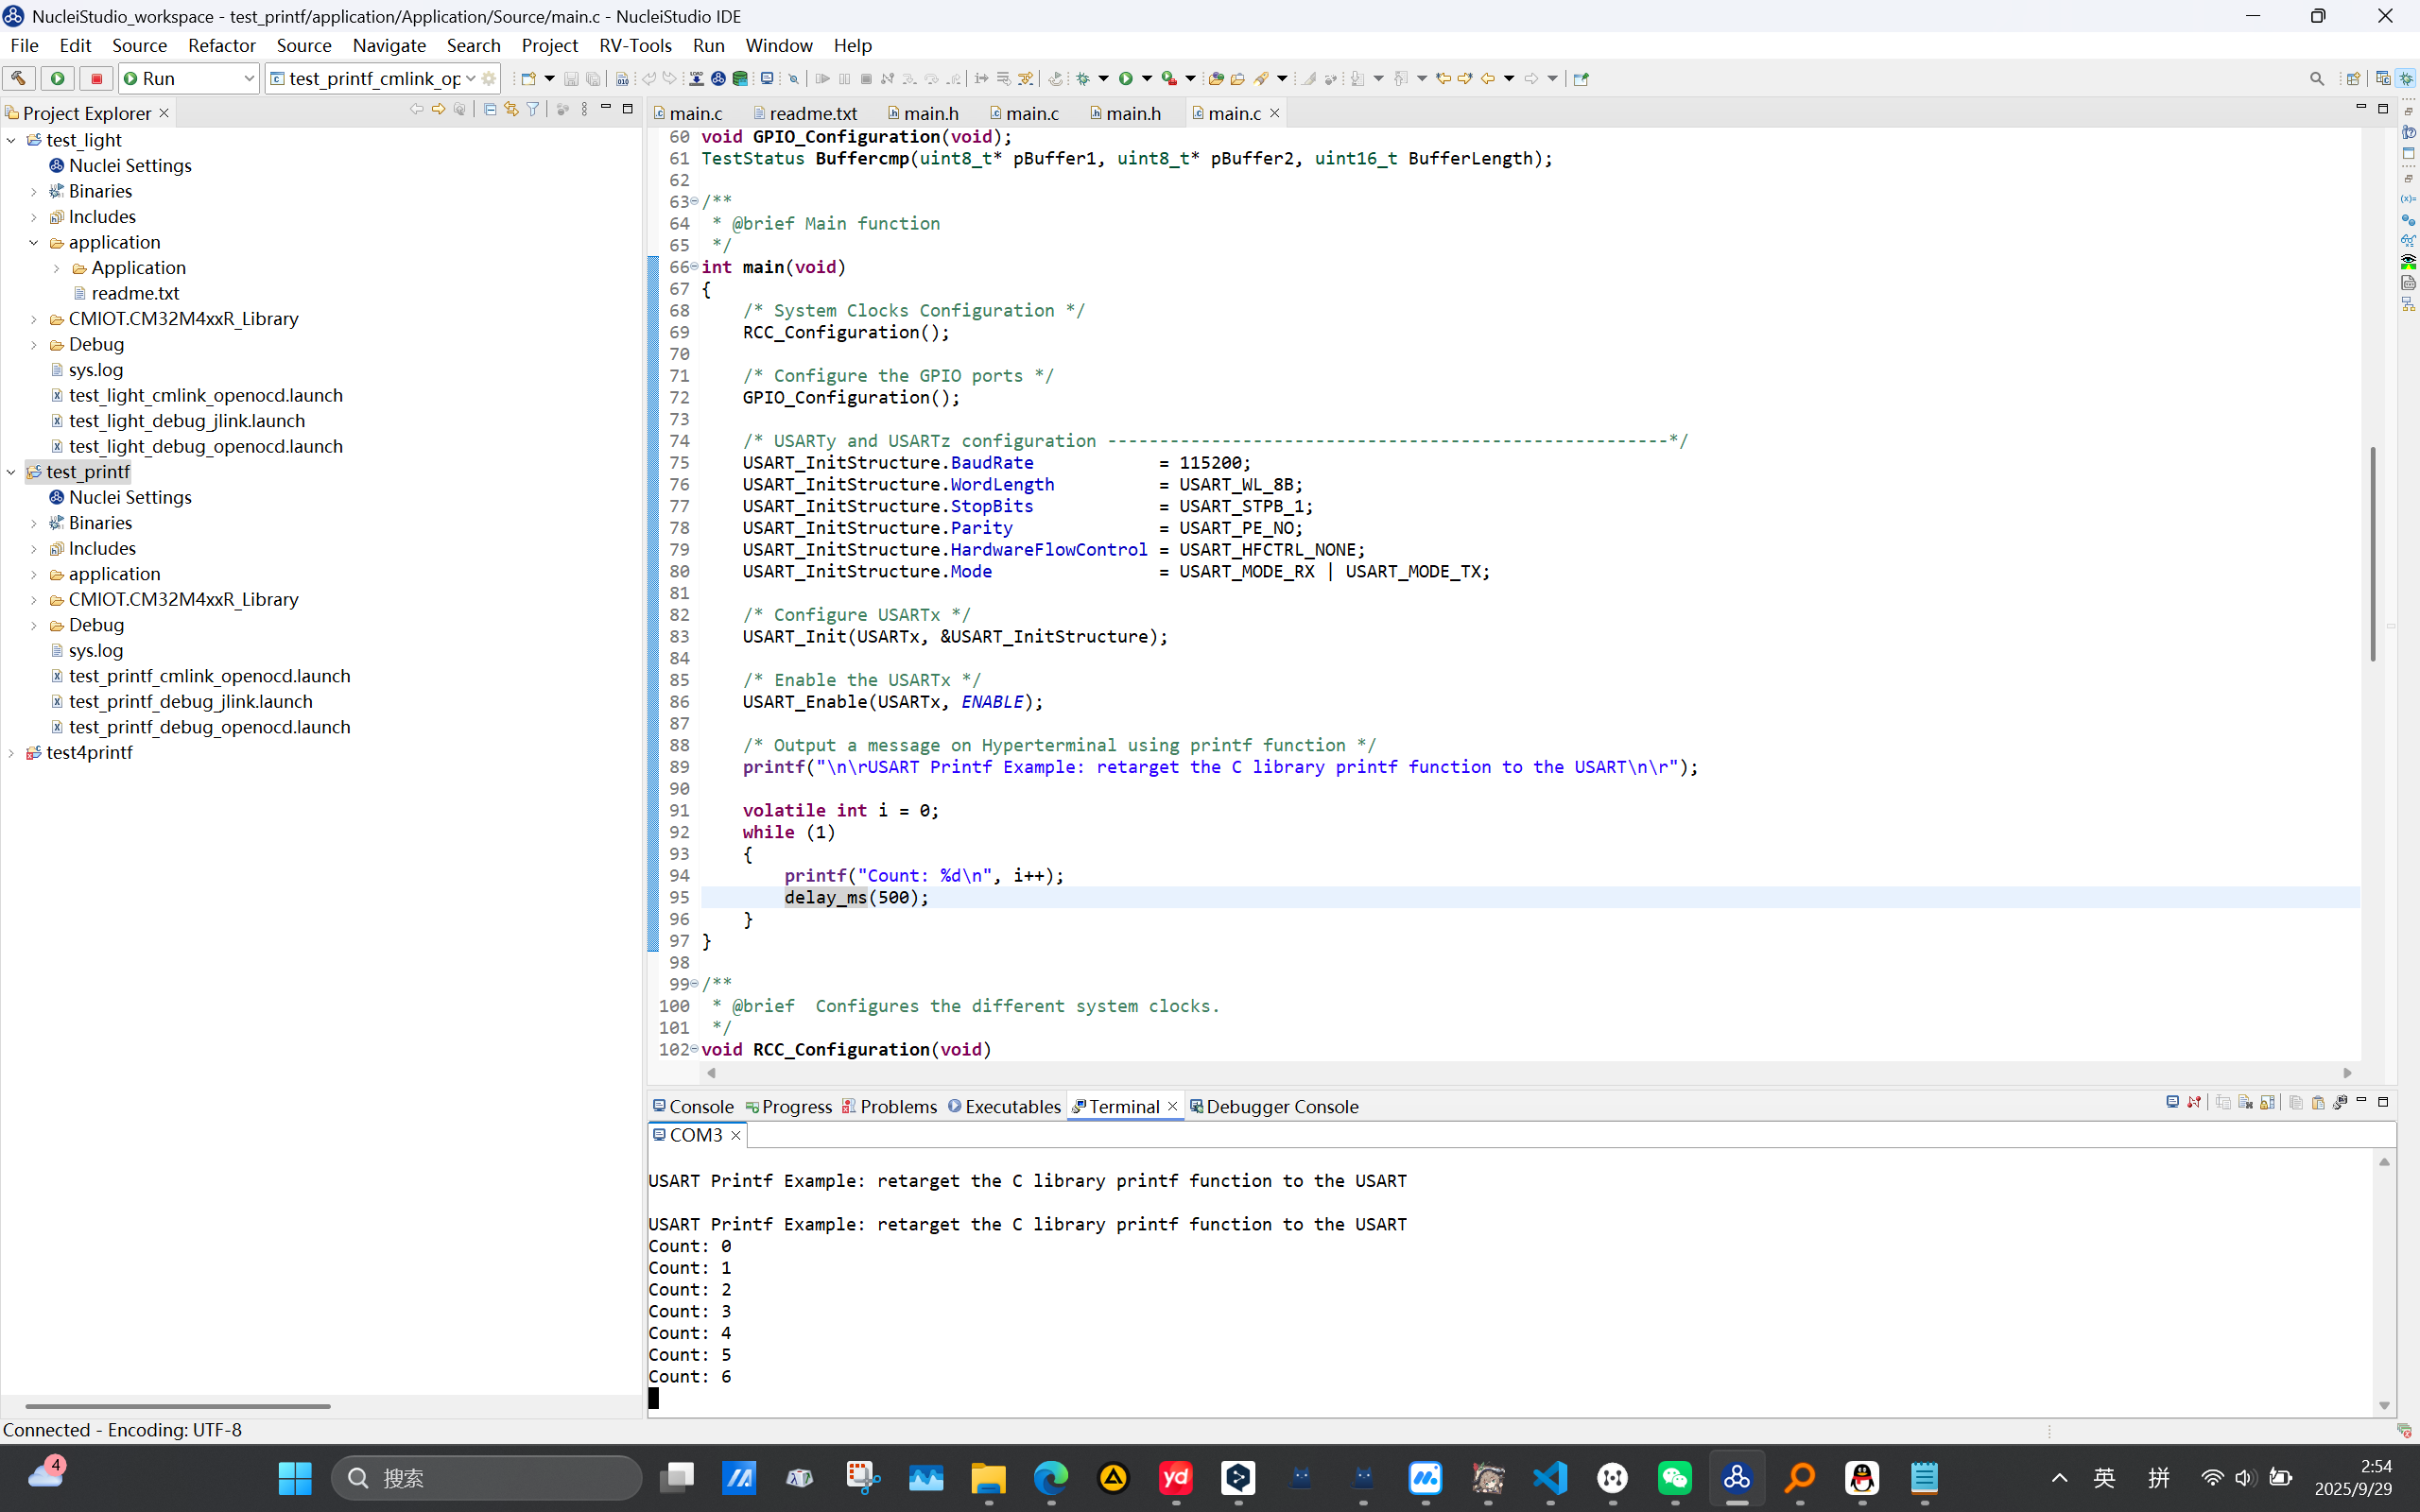
Get Familiar with Hardware – USART printf test

Slide 15
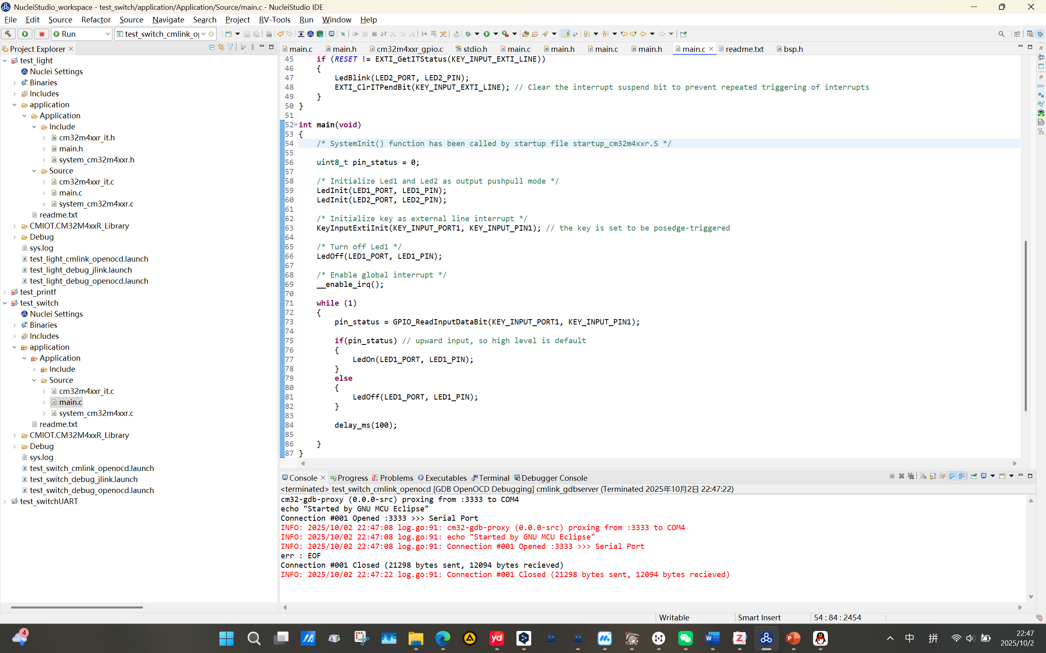
Get Familiar with Hardware – Switch & External Interrupt

Slide 16
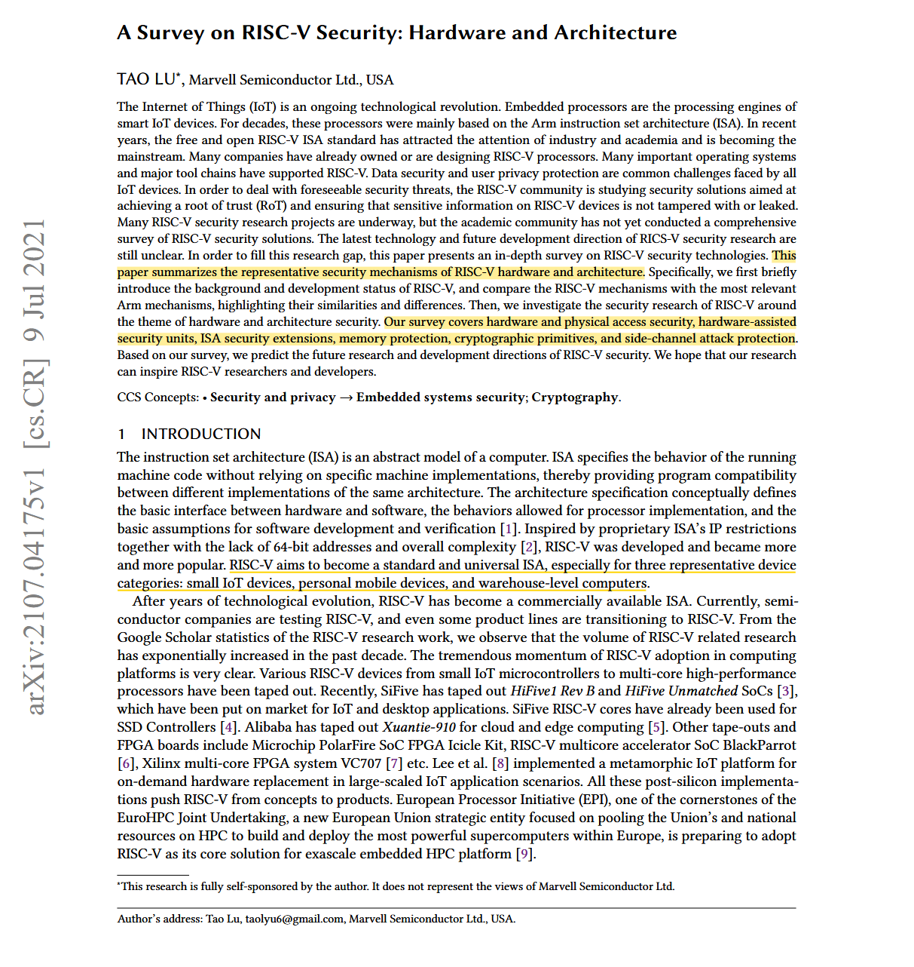
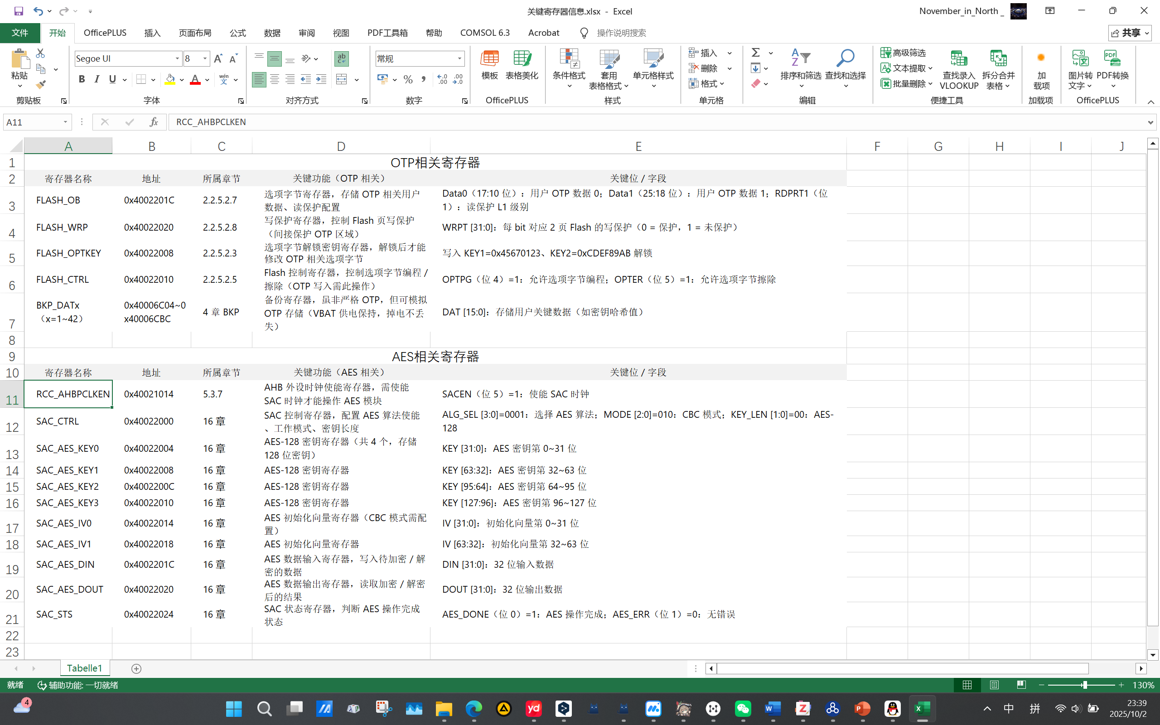
Miscellaneous
Notes of important registers
Literature reading

Slide 17
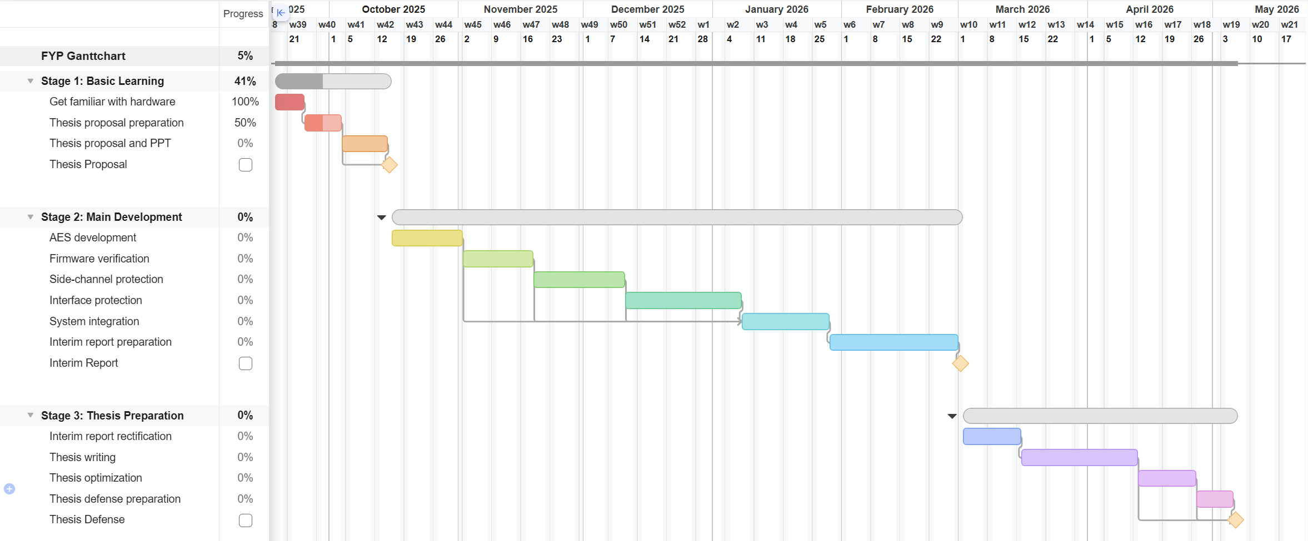
Refreshed Gantt Chart

Slide 18
Oct. 4 – Oct. 24 2025 Week 5-6 Progress
Thesis Proposal & Hardware AES-128 Implement

Slide 19
Refreshed FYP & Thesis Proposal on Oct. 15
Remove
Add
Interface protection
Ascon software implement
SAC-accelerated SLH-DSA implement
Using SLH-DSA for firmware verification
Using TVLA test for side-channel protection

Slide 20
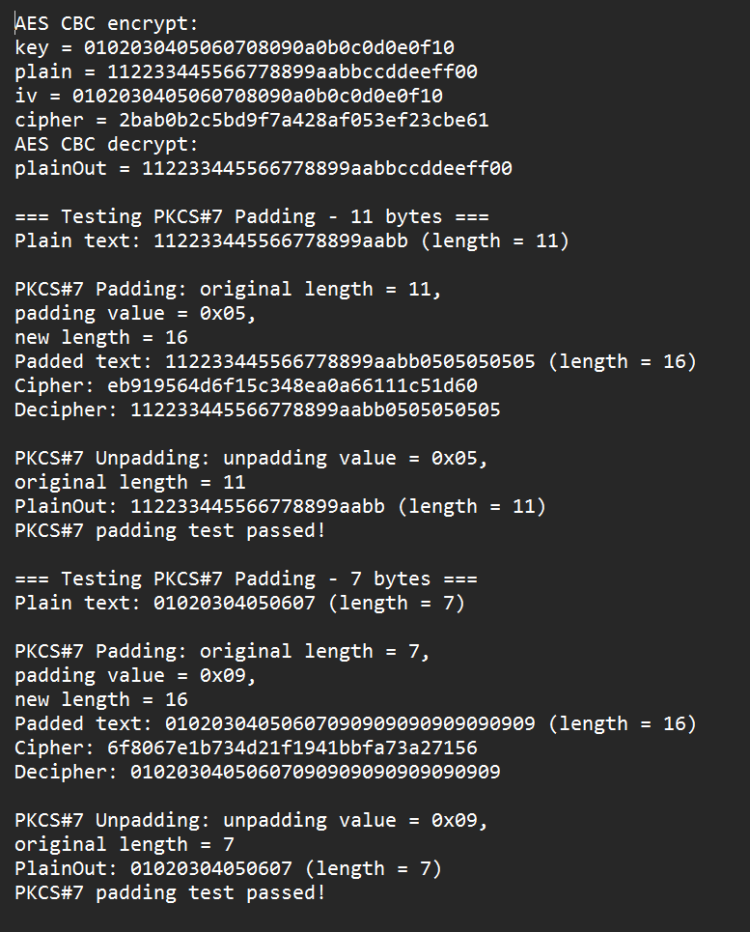
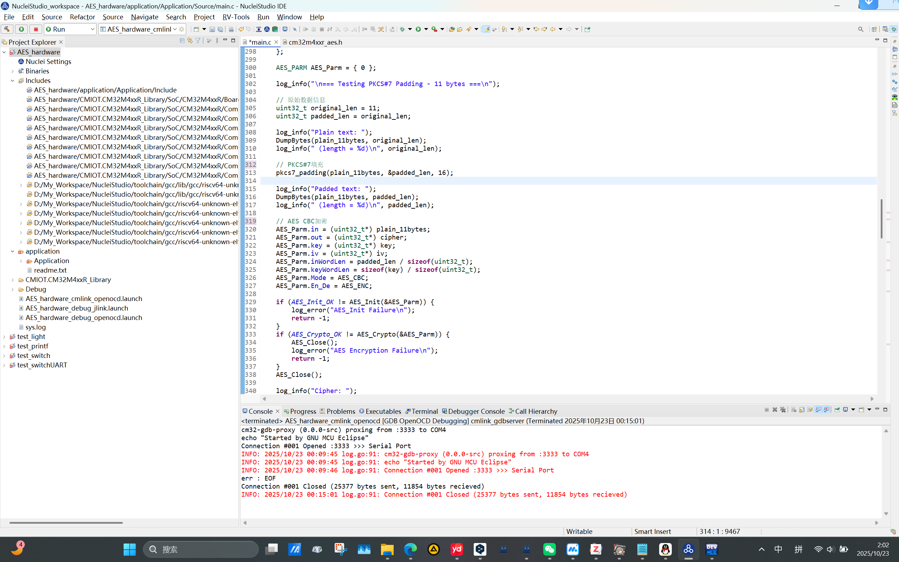
AES Hardware Implement – Basic SAC function & PKCS#7 padding

Slide 21
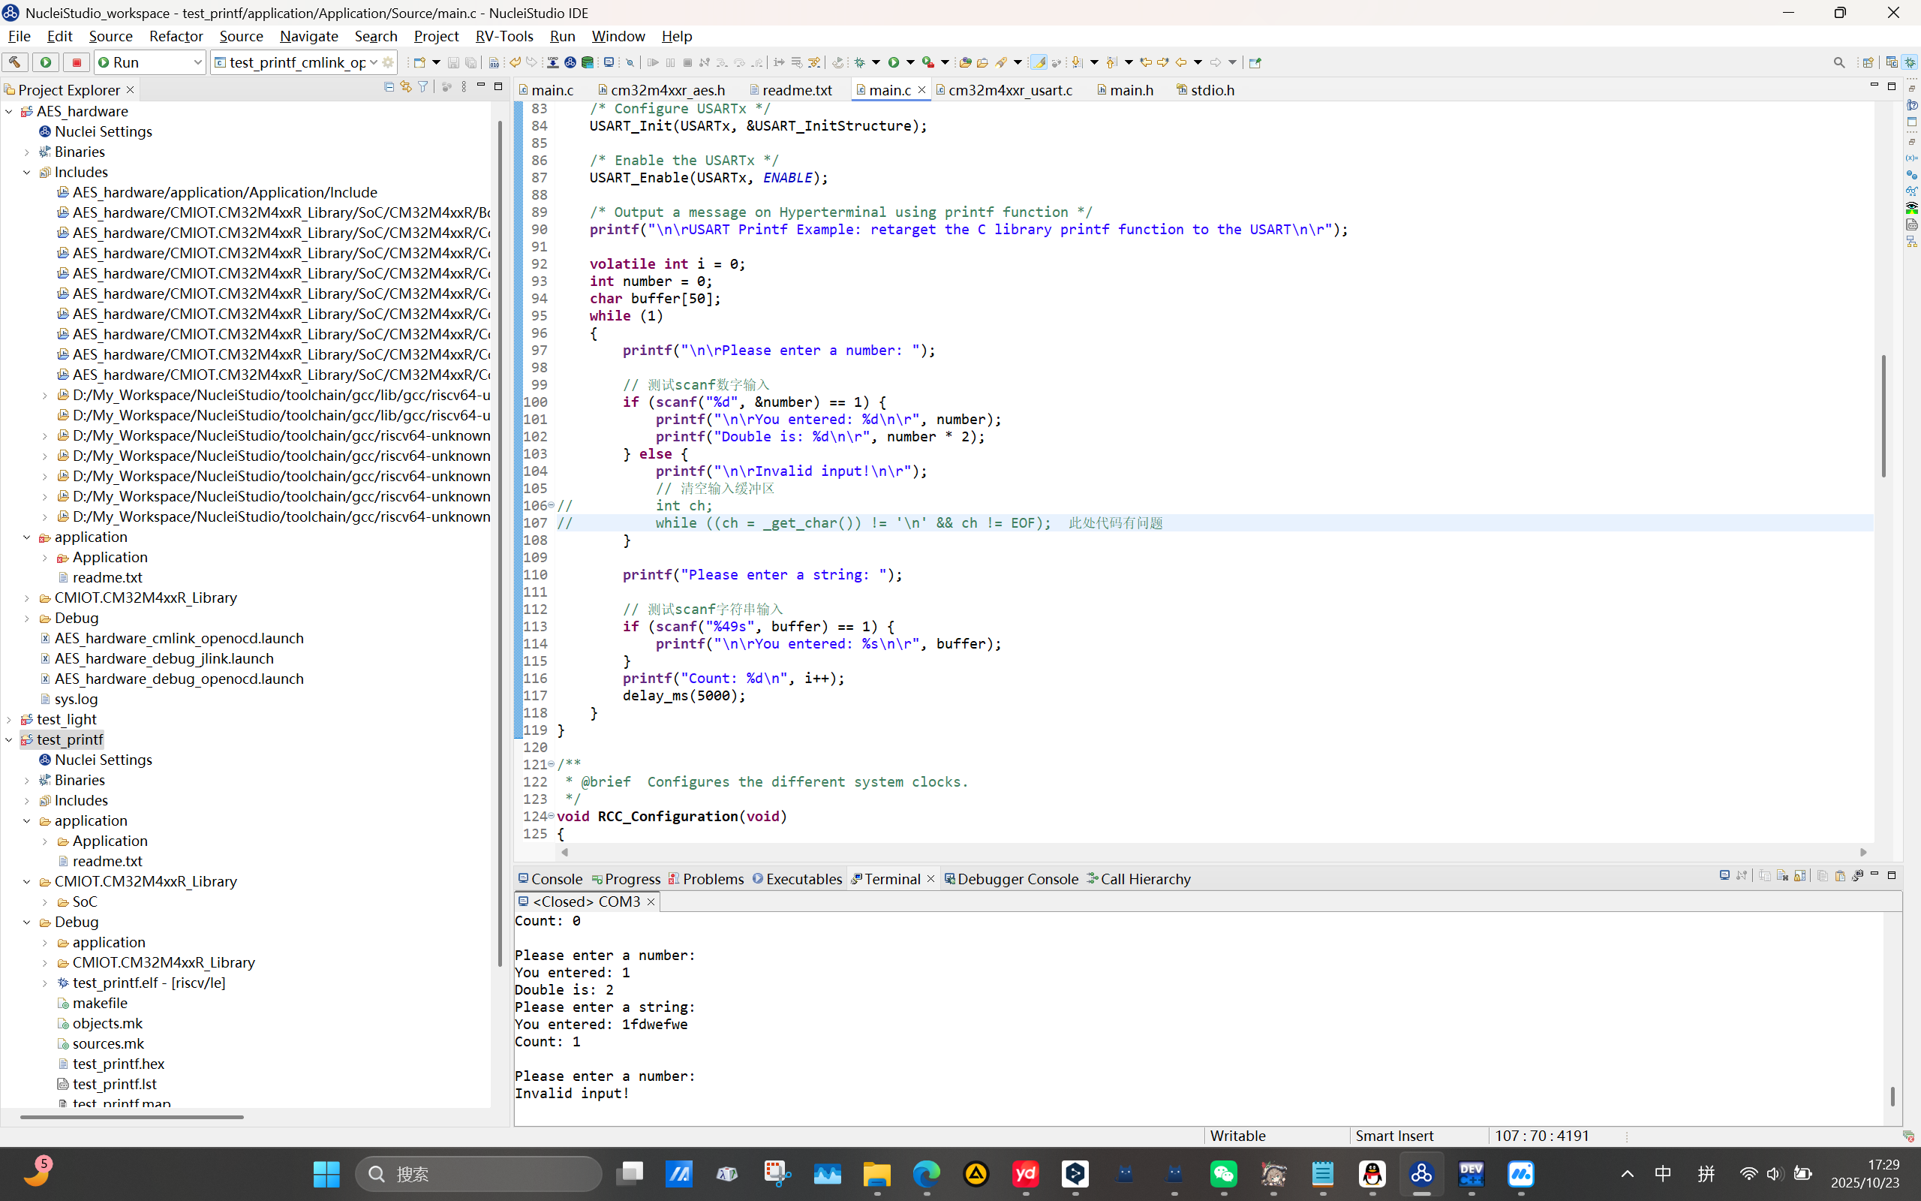
Redirect _get_char() to achieve scanf() function

Slide 22
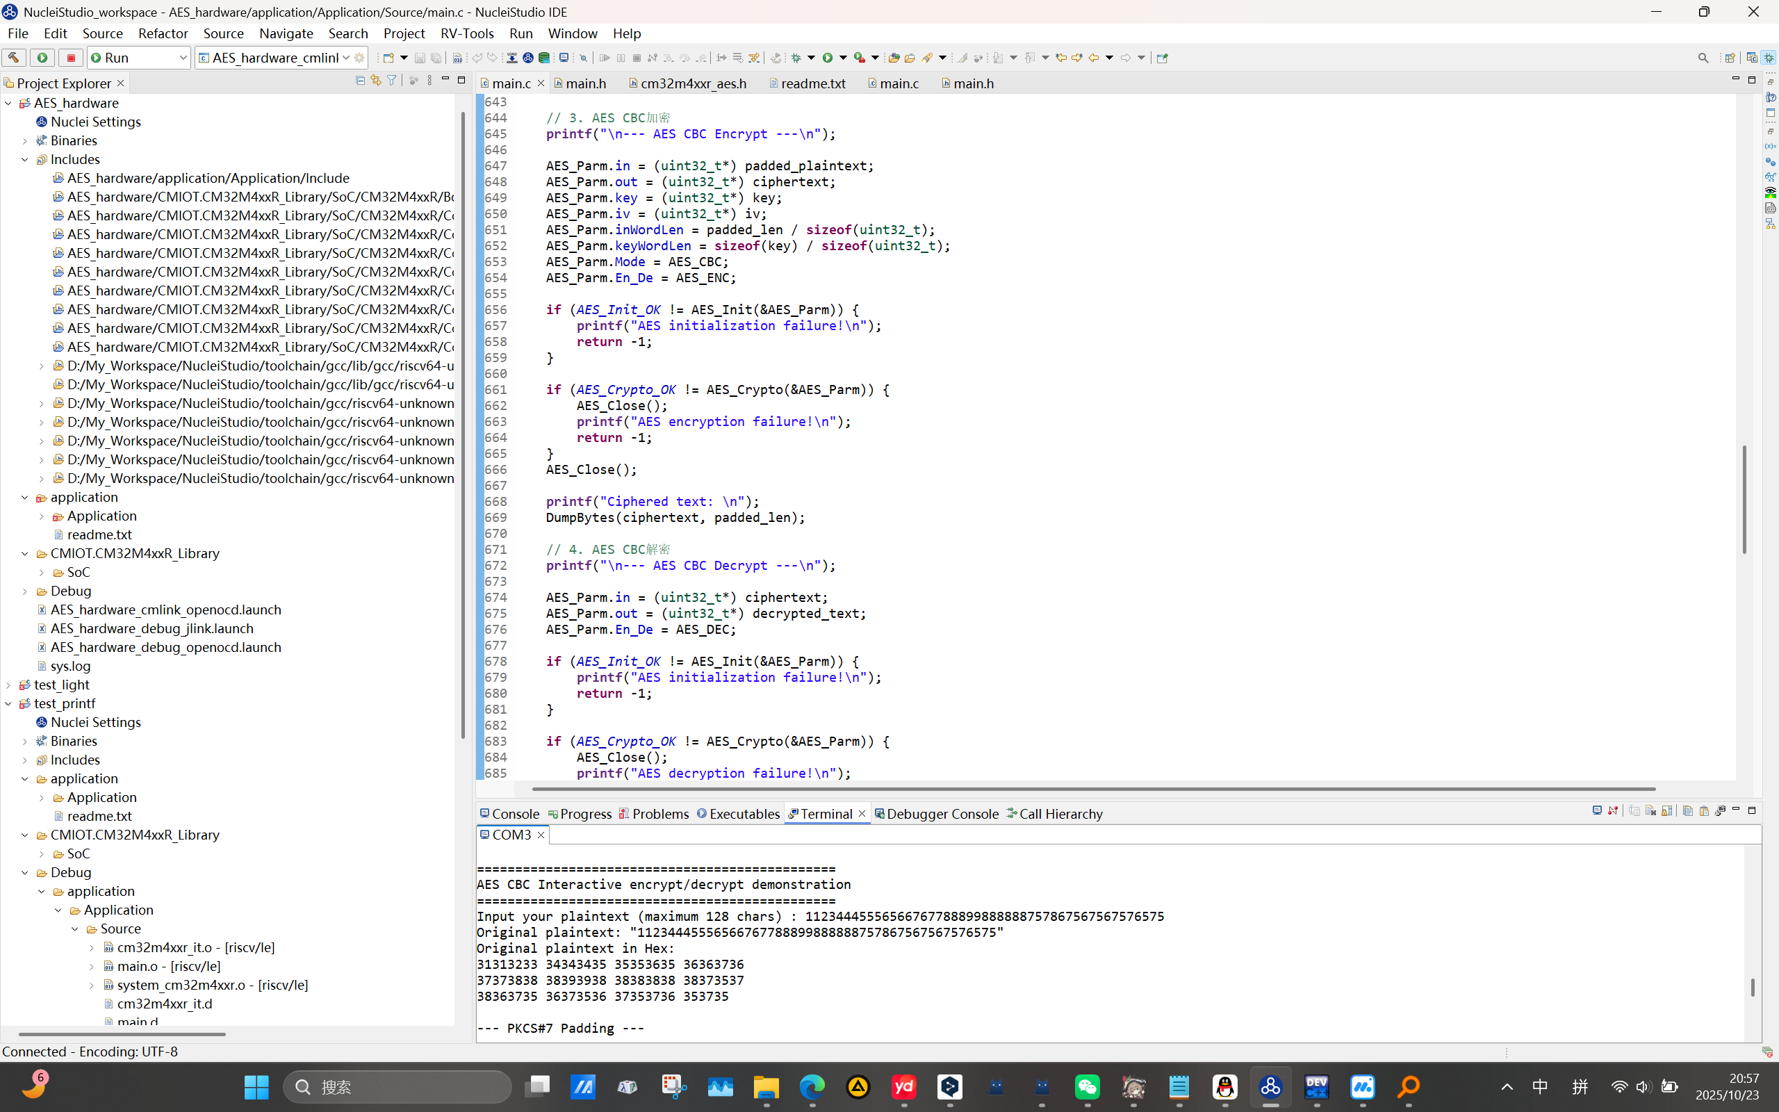
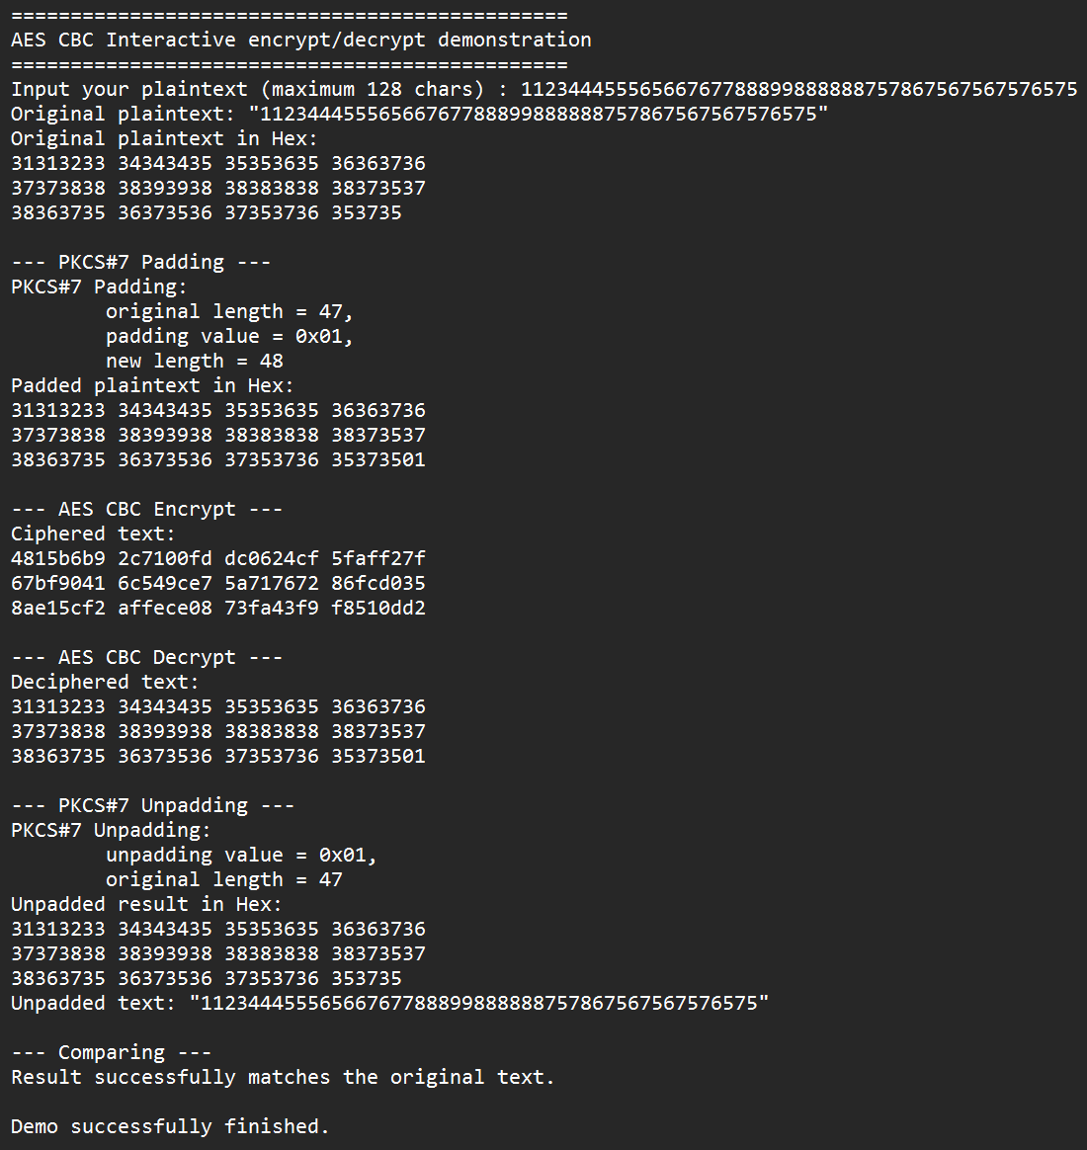
AES Hardware Implement – Introduce scanf() & customized plaintext

Slide 23
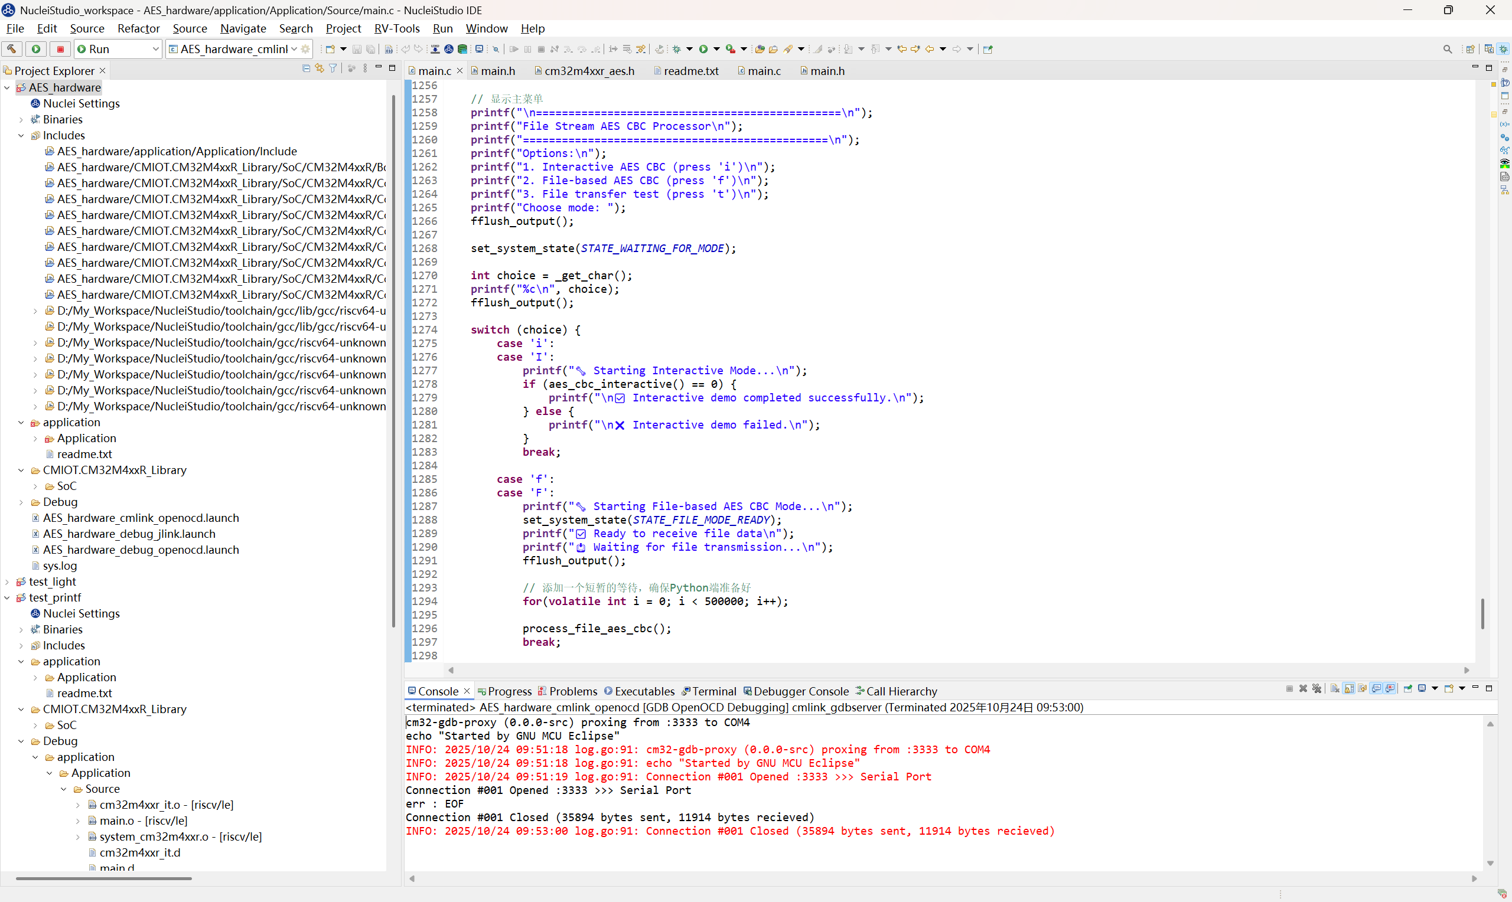
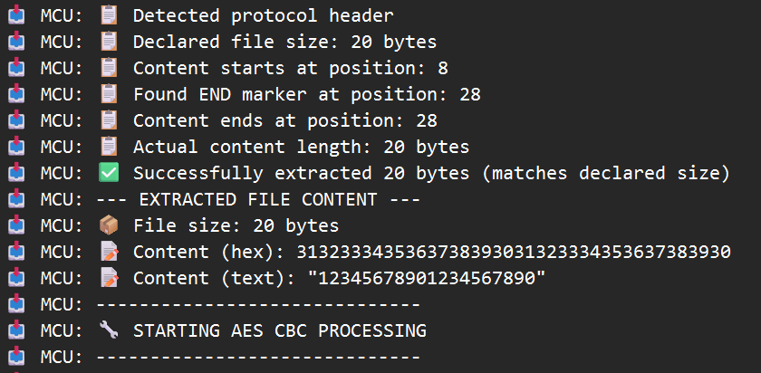
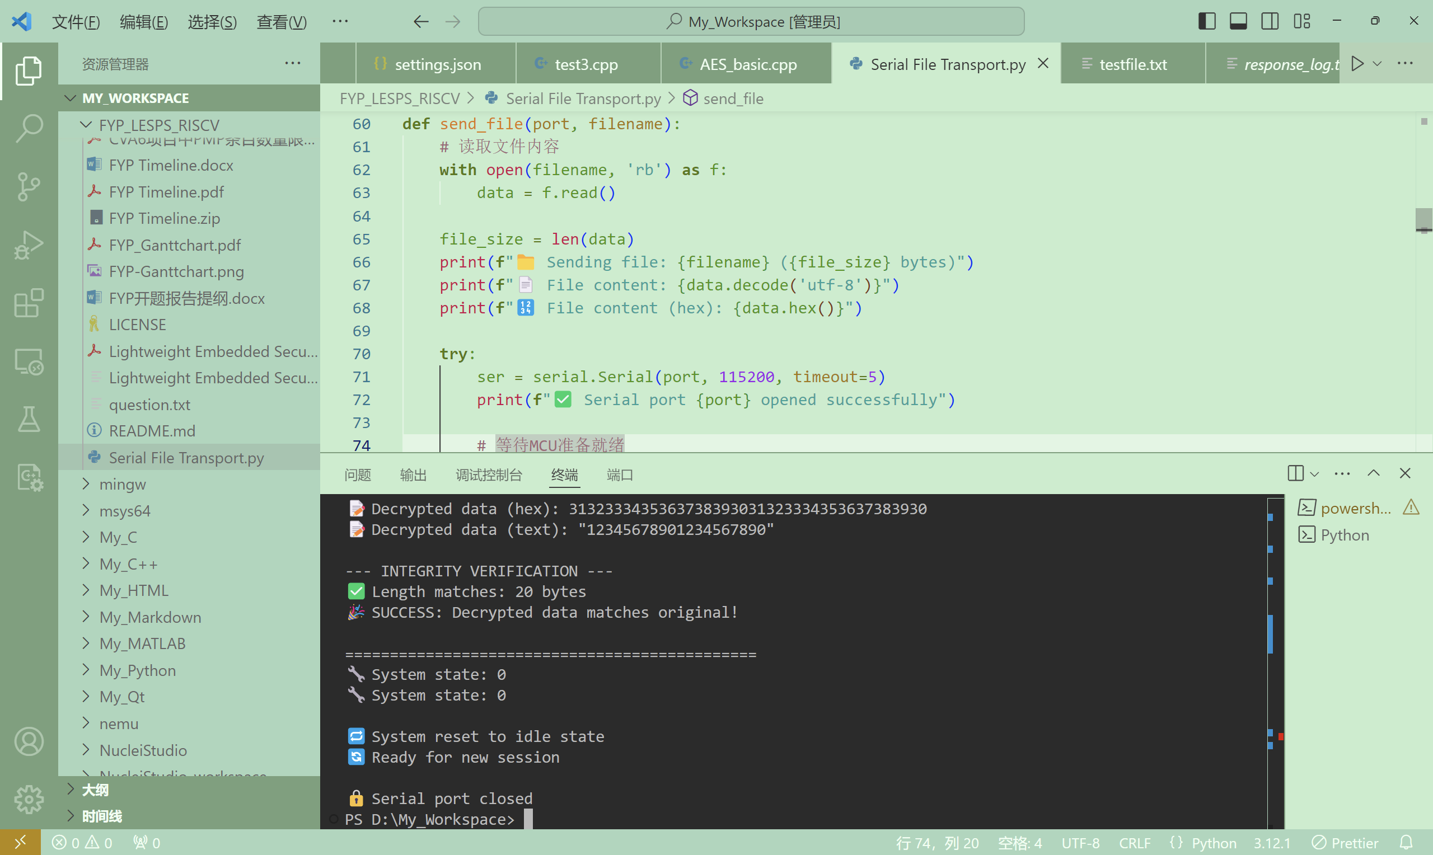
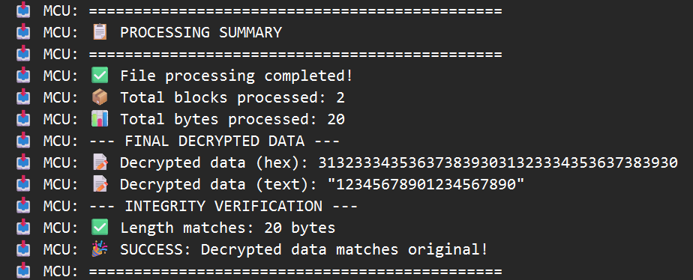
AES Hardware Implement – File Transport

Slide 24
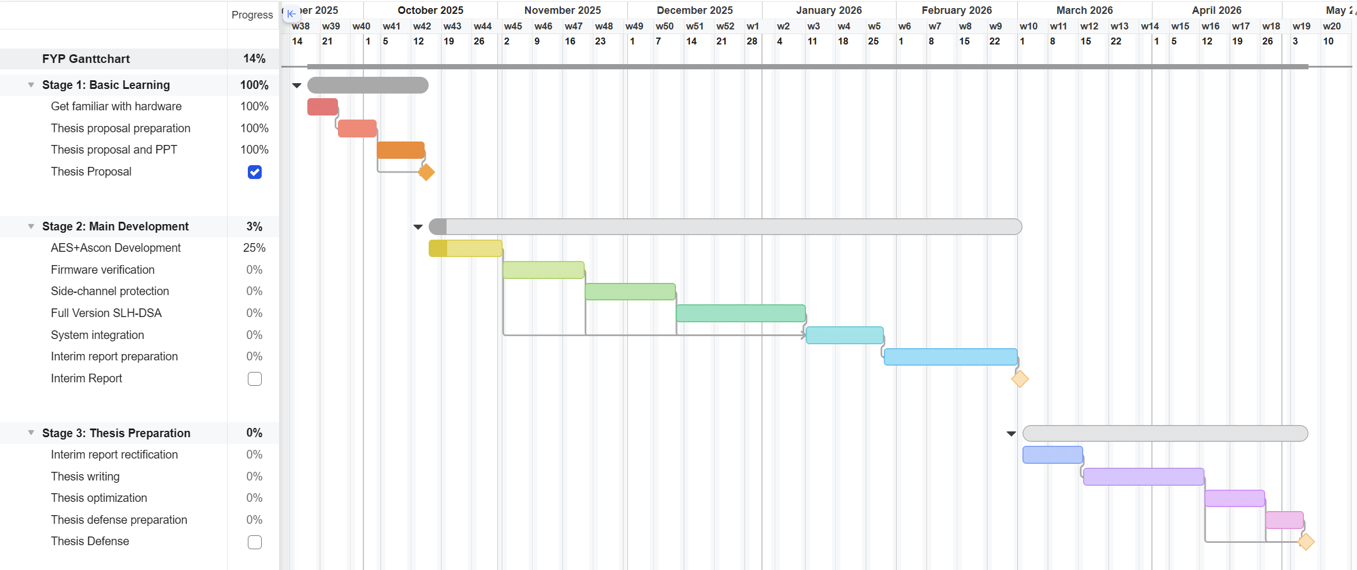
Refreshed Gantt Chart

Slide 25
Oct. 25 – Nov. 7 2025 Week 7-8 Progress
Hardware AES-128 Implement

Slide 26
Hardware AES – Large File Support
Old version
This version
Only support files that are less than 512 bytes
Immediately decrypt after encryption
Cannot save ciphered / deciphered text
Possible memory leakage in data transmission
Support files of ANY size
Decoupled operation
Can save ciphertext and output
Strict data size check during transmission

Slide 27
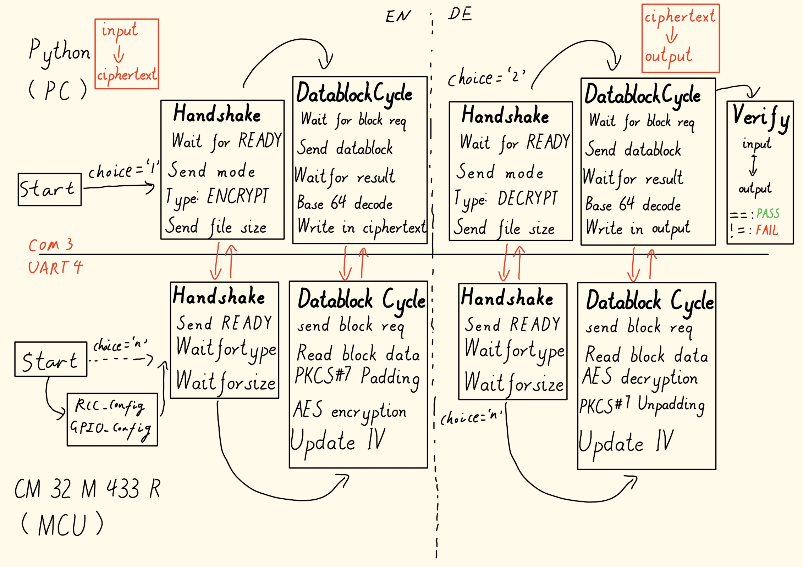
Hardware AES – Large File Support

Slide 28
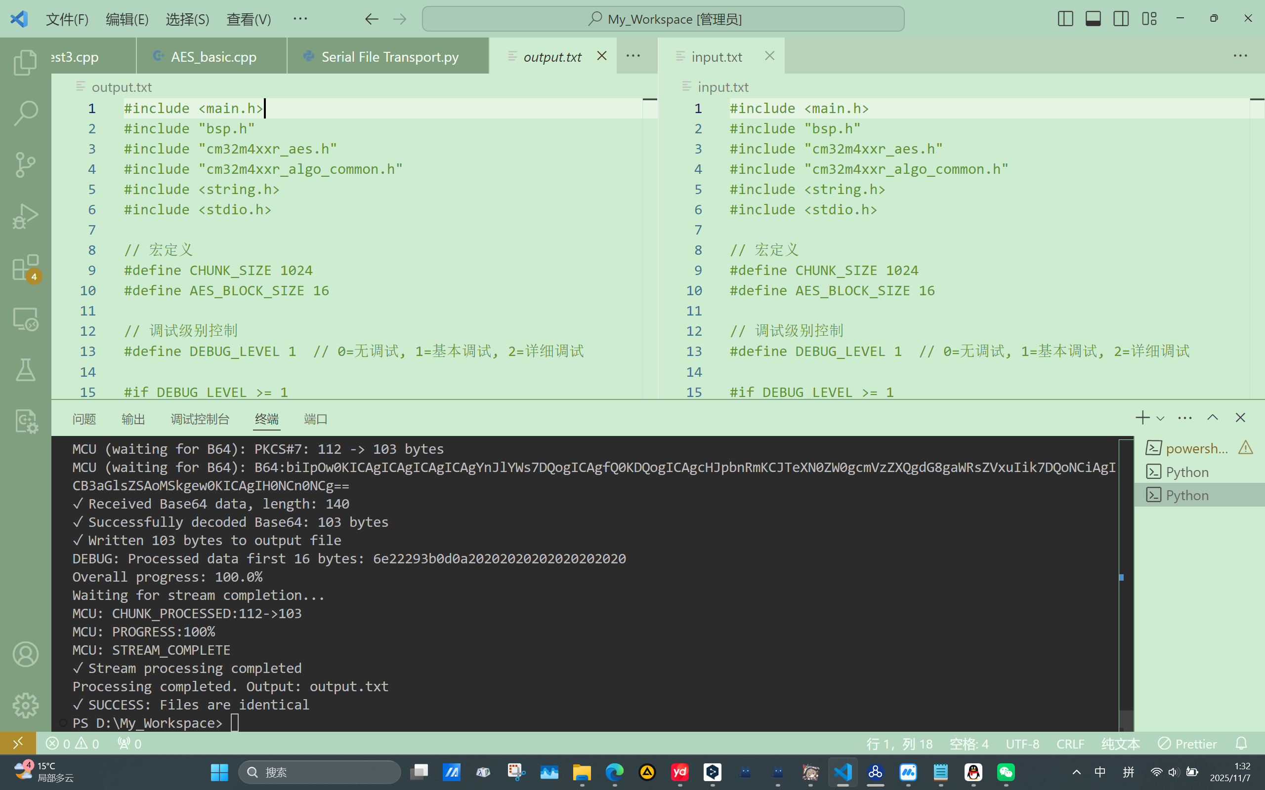
Hardware AES – Large File Support

Slide 29
Further step…
Based on the hardware AES implementation, replace the hardware AES to software AES and software Ascon
Benchmark on all the implementations and make a comparison
Move on to firmware verification part

Slide 30
Nov. 7 – Nov. 21 2025 Week 9-10 Progress
Software AES-128 Implement & Software Ascon Implement & Benchmark & Bootloader

Slide 31
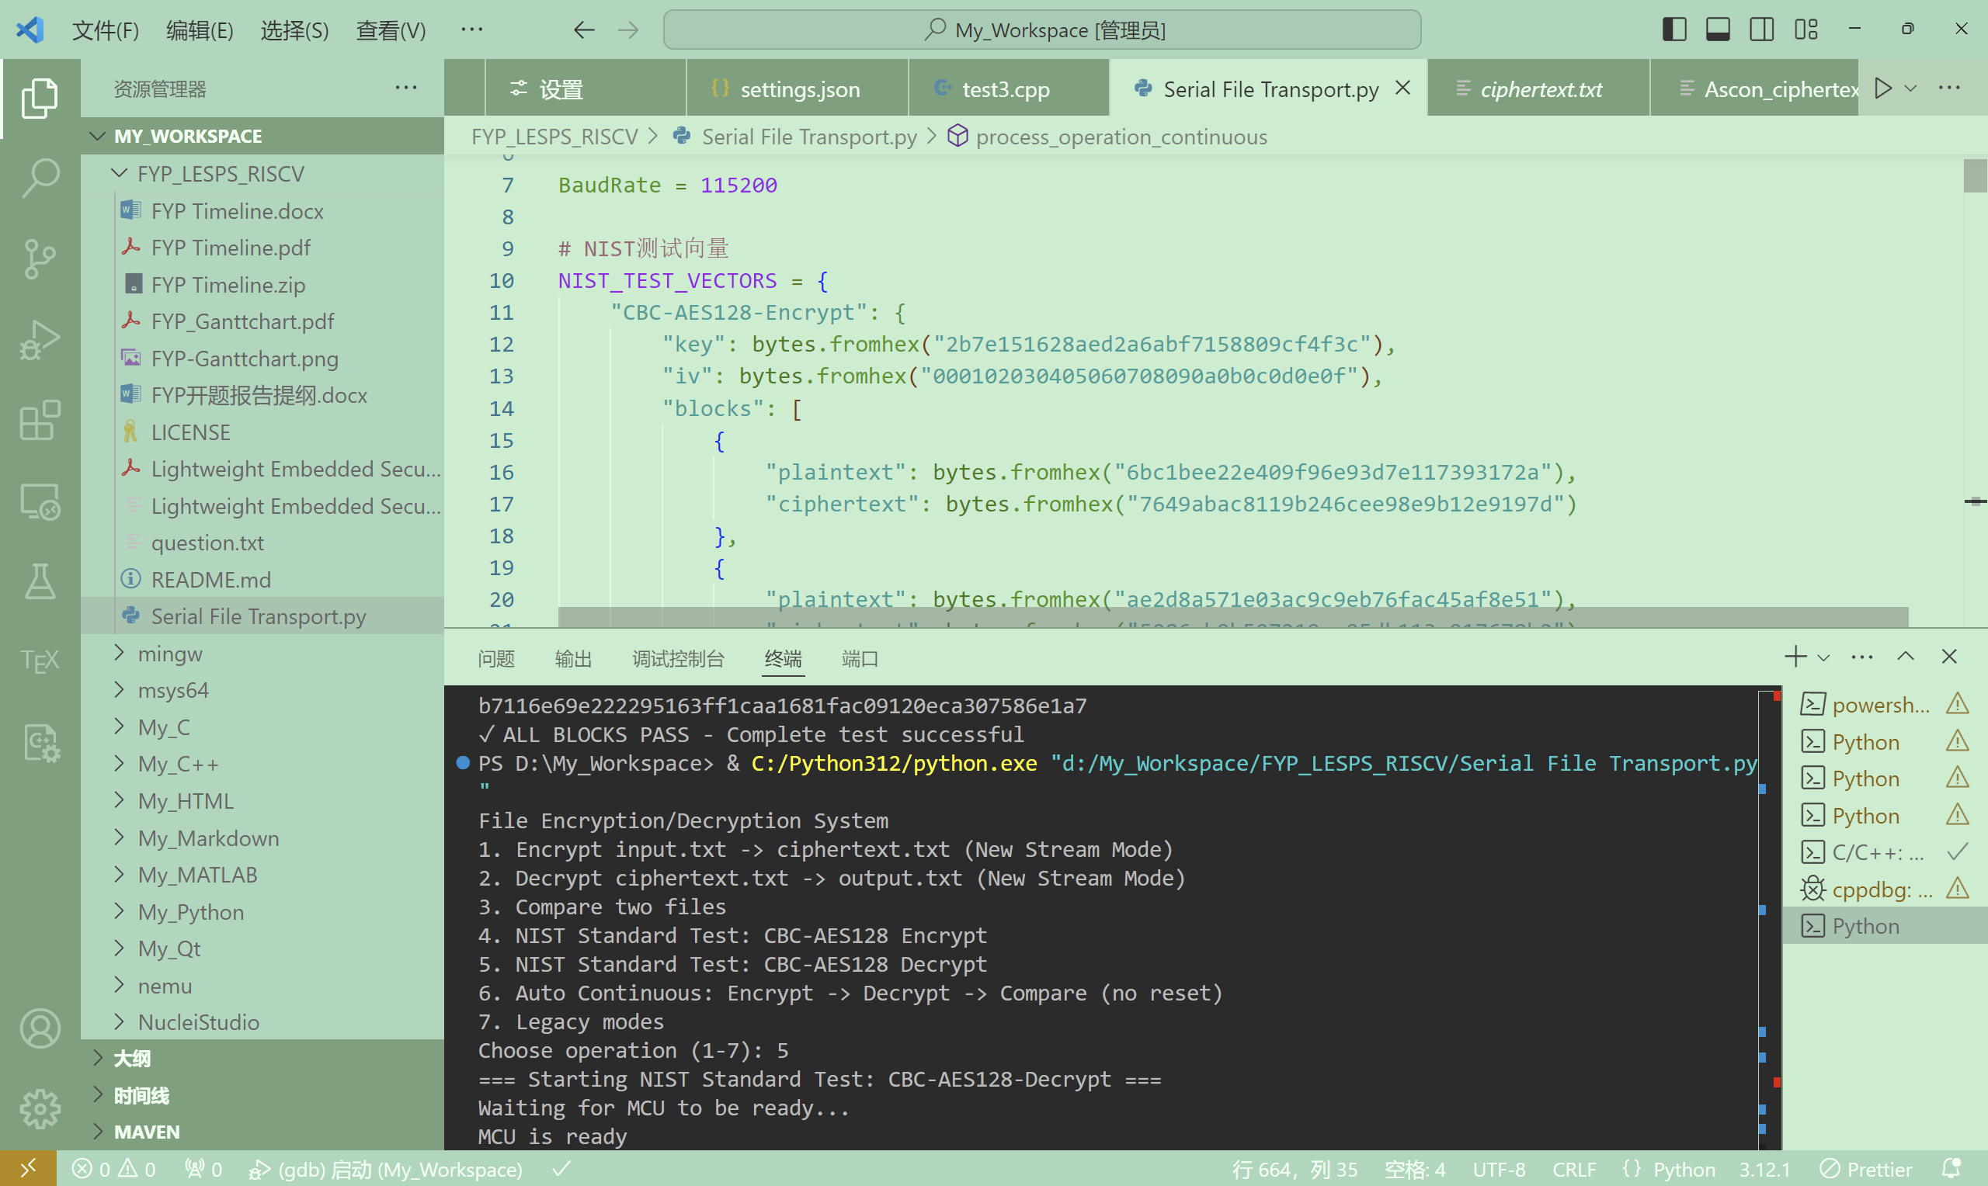
Improved Hardware AES Implementation
Complete auto test (Encrypt -> Decrypt -> Verify) without manually reset
Introduce NIST standard test vectors and auto test / verification
Now support customized key and IV
Fix the IV update logic to fit the standard

Slide 32
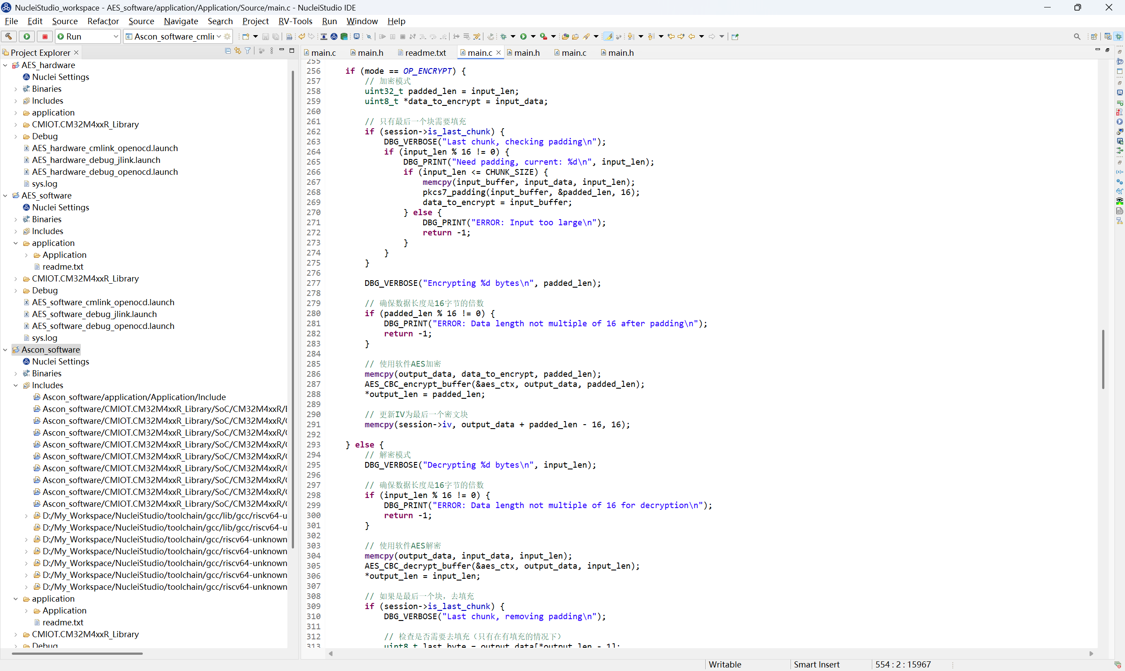
Software AES Implementation
Introduce tiny-AES-c open-source library
Simplify aes.c to just include AES-128 CBC implementation
Switch hardware AES encryption / decryption to software

Slide 33
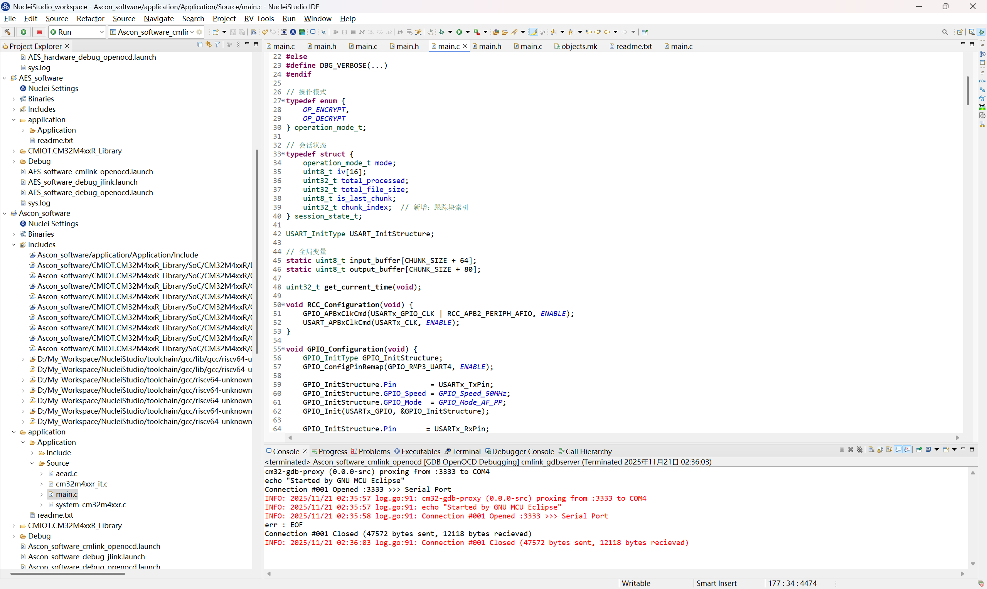
Software Ascon Implementation
Introduce ascon-c open-source library
Independently encrypt / decrypt each block, no need to pad
Challenge: the Nonce numbers need to be different between each block, but also need to be same for each block during encryption / decryption
Solution: introduce chunk index to generate individual Nonce number
Modify python script to be compatible with Ascon’s signature

Slide 34
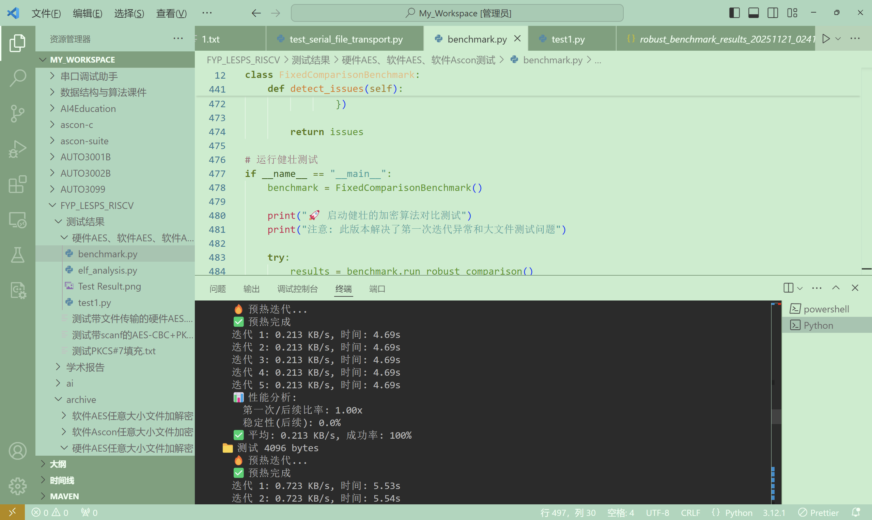
Benchmark
Basic benchmark using python script
Analyze all three implementations’ .elf file
Five-level pressure test, each has five individual iterations
Run a preheat test to exclude abnormal values
Multidimensional final result analysis

Slide 35
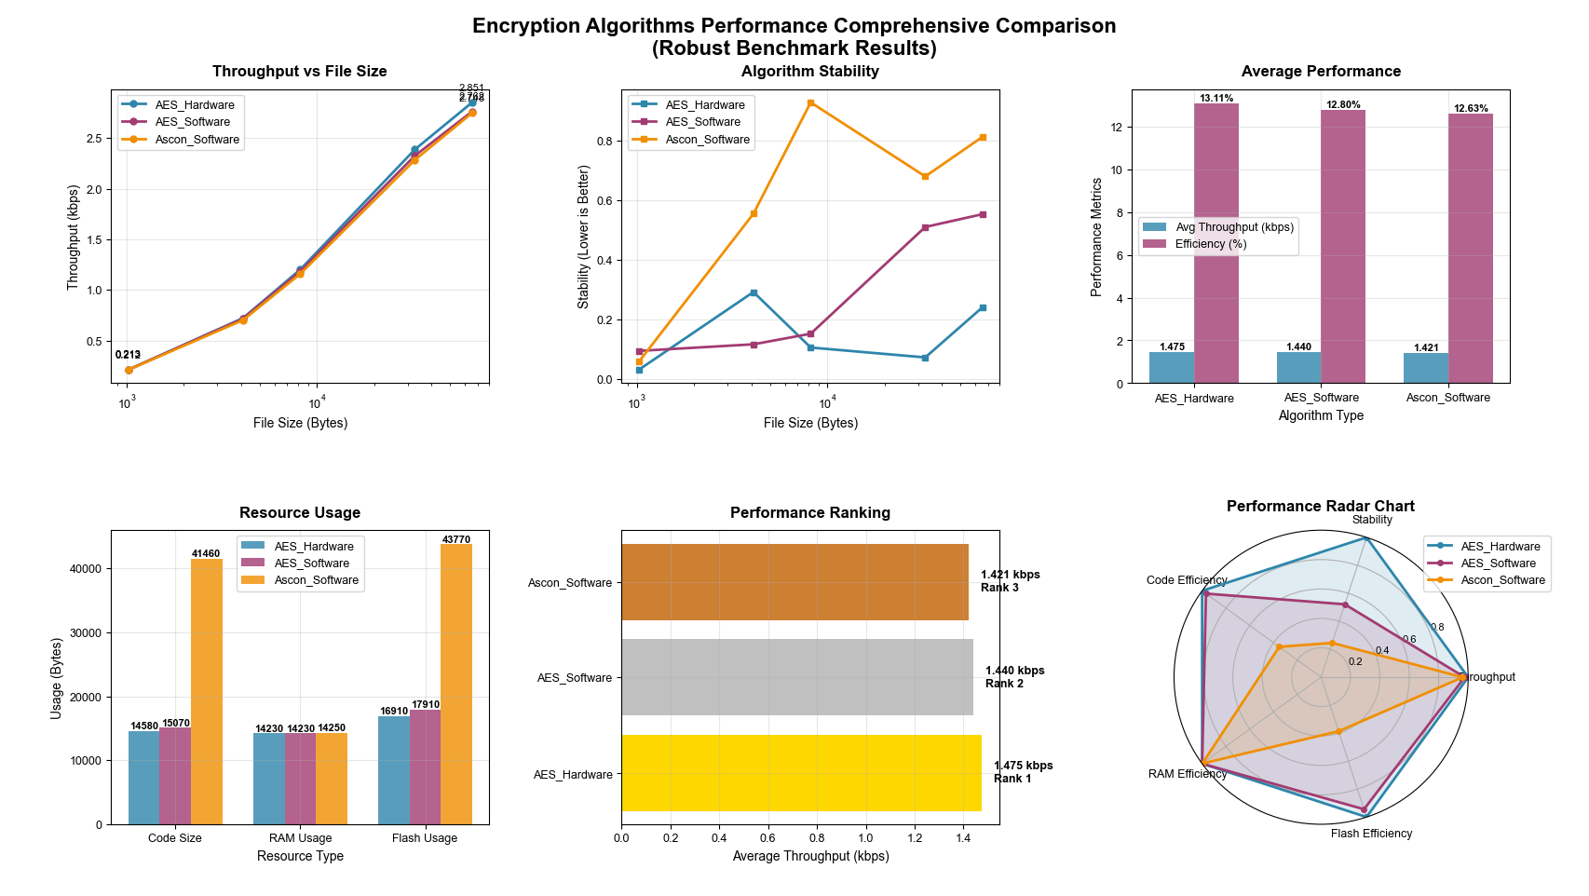

Slide 36
Nov. 22 – Dec. 5 2025 Week 11-12 Progress
AES-GCM-SIV Implementation & Benchmark

Slide 37
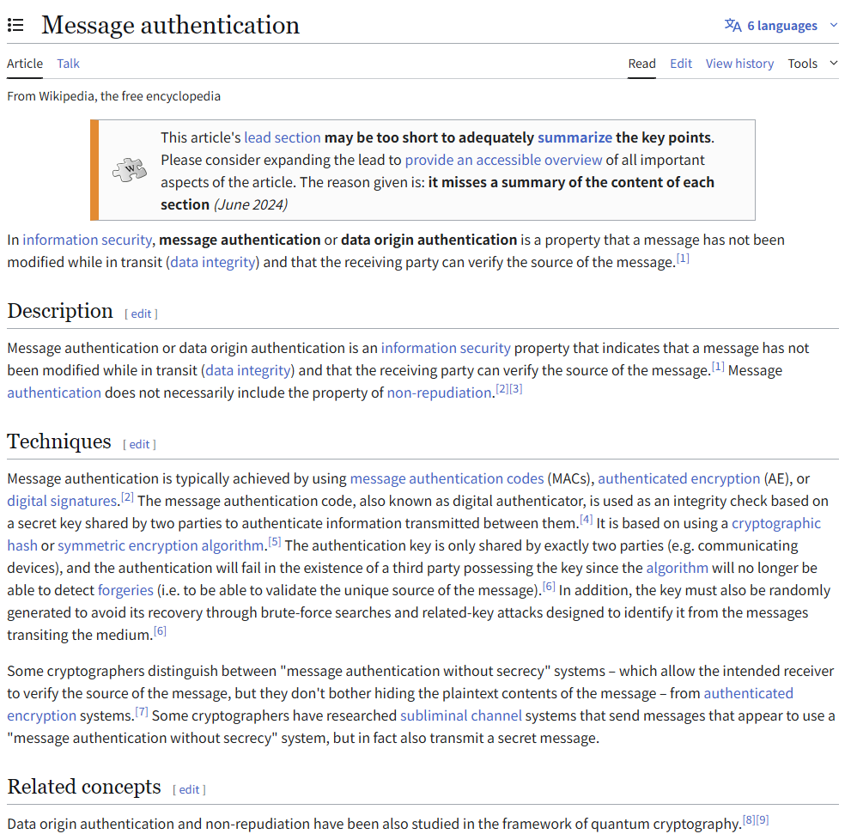
Big mistakes during benchmark in last speech
AES-CBC is an encryption algorithm
It only guarantees data’s secrecy
Ascon family is a group of AEAD algorithms
They can guarantee data’s secrecy, integrity and authenticity
Ascon’s design is naturally resistive to SCA
Ascon-128 does more jobs than AES-CBC, that’s why it’s unfair to compare their performances at the beginning
Aside from unbalanced work, my simple benchmark cannot reveal the security advantages Ascon-128 has
Also, current implementations don’t introduce side-channel protection

Slide 38
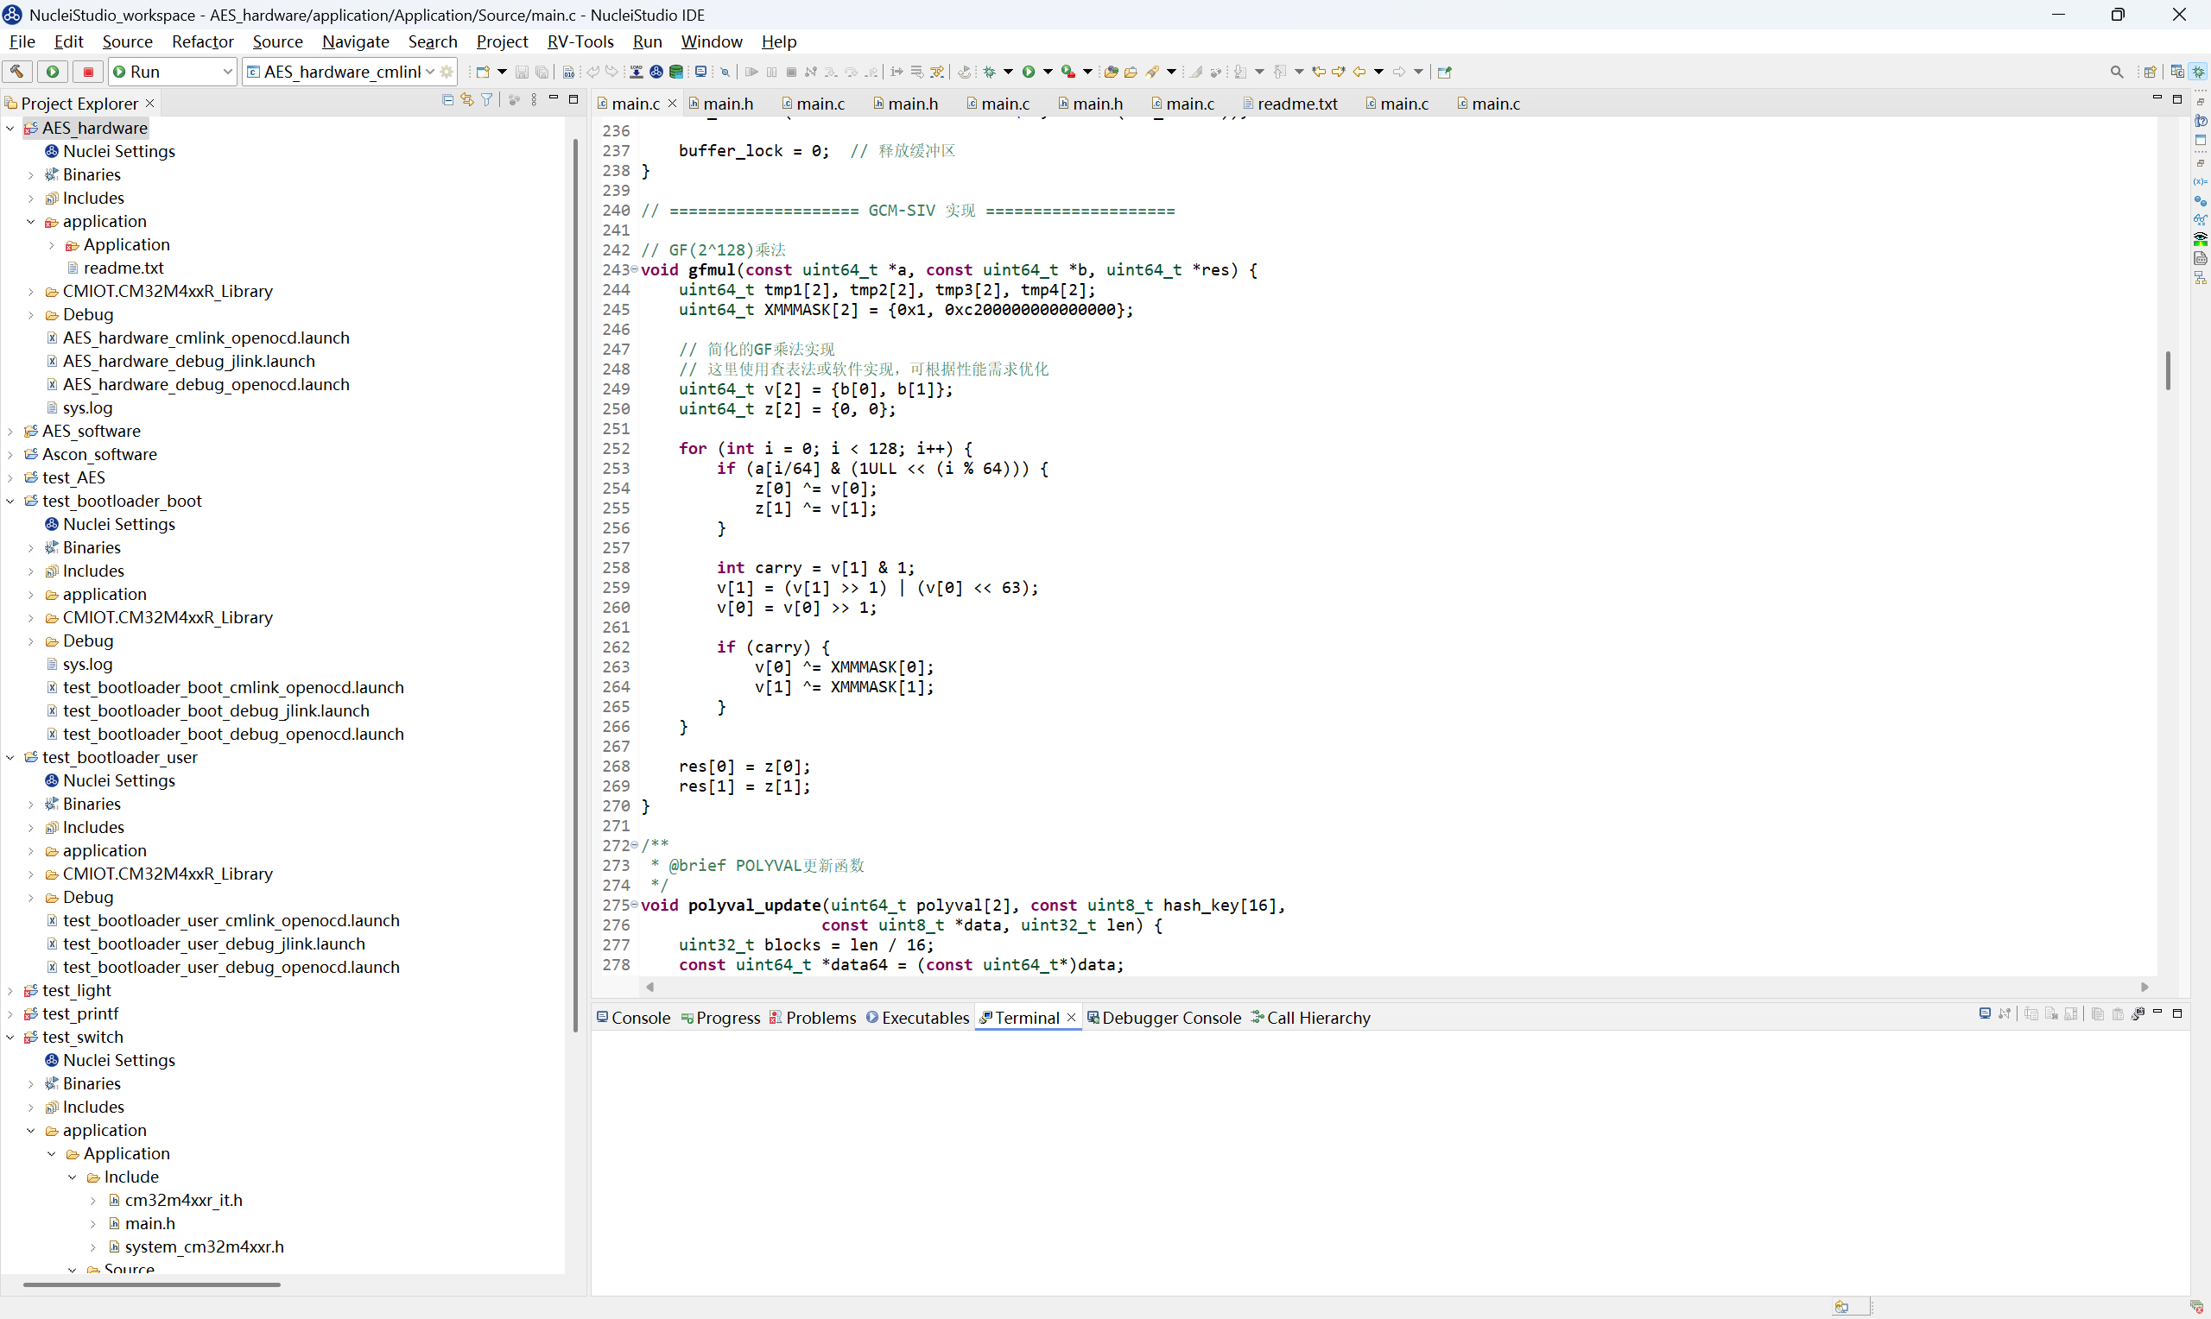
Solution: introducing AES-GCM-SIV implementation
AES-GCM (Galois/Counter Mode)
Using key and random nonce to generate IV
Using GHASH (based on Galois Field multiplication) to generate authentication tag
Disadvantage: if the same <Key, Nonce> pair is used on different messages, attackers can calculate the XOR of key stream
AES-GCM-SIV (Synthetic IV)
Nonce will be generated from SIV, not randomly generated
SIV = AES-CTR(key2, POLYVAL(AAD, plaintext))

Slide 39
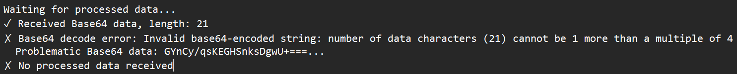
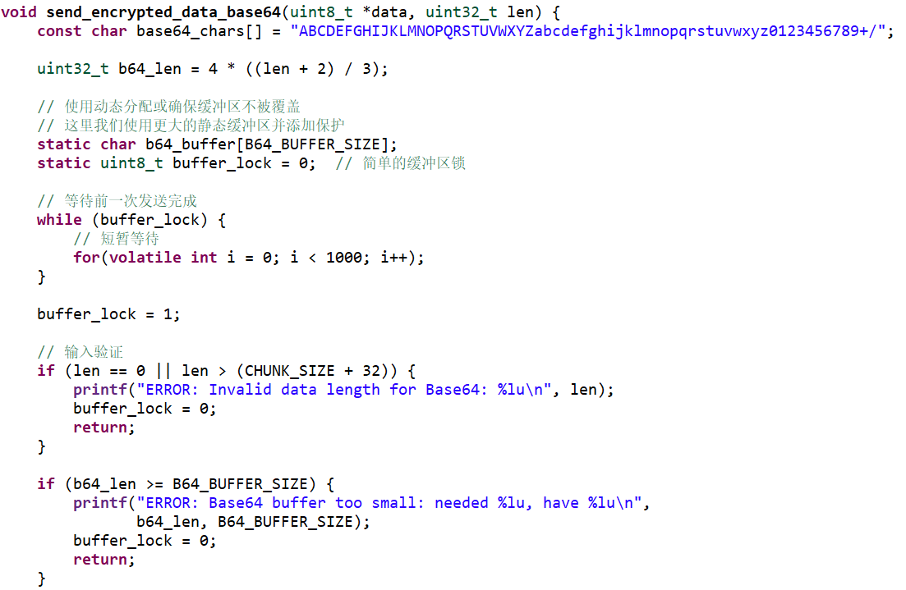
Solving Base64 incomplete data: buffer lock
Problem
Solution
When the plaintext is large enough, all the implementations will fail due to incomplete B64 data
Though the exact data might be different, the position and the length of failing data are identical with regard to the same input
Such replicate pattern suggests that there might be data overflow in B64 process buffer
Introduce simple buffer lock and minor delay
The B64 process buffer will not be refilled until after a delay controlled by buffer lock
After modification, hardware AES-GCM-SIV succeeded at encrypting & decrypting a massive 23MB input file (previous code will fail at around 60KB)

Slide 40
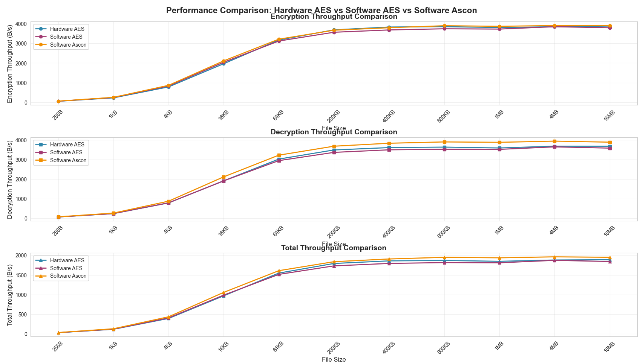
Simple Benchmark Result
Testing throughput (right graph) and other indexes (next page)
As input file goes larger, all three’s throughput stabilizes at around 3.6 KB/s
Ascon has the highest average throughput and most balanced performance between en/decryption, but also the largest code size
Hardware AES has advantage in small file’s encryption and shows the best stability
Software AES has the best code efficiency (smallest size)

Slide 41
